Slide 1
How to use this deck
Name | Red Hat Ansible Automation Platform Technical Deck
Purpose | To deliver to customers and partners a high level introduction of the Red Hat Ansible Automation Platform and its value and benefits. Slides 2-54 are meant to fit in one hour meeting while the use-cases (post slide 54 thank you slide) can be brought in depending on the customer persona. **Note: Deck contains speaker notes.
Last Updated | July 2020
What this deck is for? | Technical overview of the Red Hat Ansible Automation Platform
What this deck is not for? | This is not for a deep dive technical conversation.
Owner | Sean Cavanaugh; Ansible MBU, ansible-pmm-tmm@redhat.com
List of all official Ansible content | Red Hat Ansible Automation Platform One Stop https://redhat.highspot.com/items/5966647572ad8e20778bc270?lfrm=srp.10

Slide 2

Automation for all
Ansible technical introduction and overview

Slide 3


Automation happens when one person meets a problem they never want to solve again
Notes:
We’re faced with numerous challenges in IT. You live them every day. Regardless of your role or responsibility.
Effort->time; time->money…
BUT Effort has a human toll.
In the end, we’re just people. People trying to work with other people, and force machines to do the work to be done.
Your reasons for automating are pretty straightforward. You’re tired of doing the same thing over and over again.
Automation makes our jobs and lives easier.
It presents an opportunity to do more.

Slide 4

Ad-hoc Automation is happening in silos
Ansible used in silo
Developers
Is organic
automation enough?
DIY scripting automation
Security
Open source config management tool
Infrastructure
Proprietary vendor supplied automation
Network
Notes:
placeholder slide silo automaton versus holistic ansible != platform

Slide 5
Teams are automating...
Lines Of Business
Network
Security
Operations
Developers
Infrastructure
Notes:
We know that teams are automating using Ansible Automation. But not all companies automate in the same way or with as many teams.
And we know that the value of a tool, product or platform is dependent on what you can do with it… and how quickly you can get your teams and organizations to “ideal state”.
So how do we accelerate our efforts so that we can more quickly respond to demands from key stakeholders, users, customers and communities.
We want to help you automate faster. How?
Helping more teams automate
Extending use cases
Making it easier to get started
We need to make it easier for all teams to automate, and communicate those automations to one another. Automation starts w/ one, then grows. Same thing happens with customers-- they’ll start w/ 100 nodes, and then grow and scale as they find more use cases. Solving more problems--faster

Slide 6




Why Ansible?
Powerful
Agentless
Simple
Human readable automation
No special coding skills needed
Tasks executed in order
Usable by every team
Get productive quickly
App deployment
Configuration management
Workflow orchestration
Network automation
Orchestrate the app lifecycle
Agentless architecture
Uses OpenSSH & WinRM
No agents to exploit or update
Get started immediately
More efficient & more secure
Notes:
In contrast to other solutions Ansible is simple to use: no special coding skills are required, automation is human readable. This means less required training to bring Ansible to teams and thus a faster ramp-up time. Also, even people with fewer technical skills can participate in the automation, so the automation can be implemented more widespread and across more domains compared to other solutions, so the automation can be more effective.
In contrast to other solutions Ansible is powerful: it is not limited to only server configuration management, or cloud resources, but covers all kinds of IT; infrastructure, cloud, but also networking, security, app deployment, etc. Thus with Ansible there is no need to buy multiple different products for all the IT domains to automate them, there is only one tool. Also, since there is only one tool, it offers the opportunity to implement cross domain automation, bringing teams and processes together across IT team boundaries (like storage and networking, or developers and security).
In contrast to other solutions, Ansible integrates: there is no need to replace existing tooling and restart already existing efforts. Instead, Ansible integrates with what is there and helps connect it to the rest of the IT landscape in automated processes. Businesses don’t have to start all over again with their automation efforts with Ansible, but can seamlessly use it to fill gaps and tie together ongoing efforts. Existing investments are preserved as much as possible, Ansible “connects the dots”. This is enabled and supported by Ansible’s agentless architecture: Ansible can connect to what is already native to the tools used in the customer’s datacenter already. There is no need to bring in new agents, or introduce new layers of communication to start automating.

Slide 7
What can I do using Ansible?
Automate the deployment and management of your entire IT footprint.
Do this...
Orchestration
Configuration Management
Application Deployment
Provisioning
Continuous Delivery
Security and Compliance
On these...
Firewalls
Load Balancers
Applications
Containers
Clouds
Servers
Infrastructure
Storage
Network Devices
And more...
Notes:
Ansible Automation has many use cases outside of just configuration management. Ansible can perform provisioning, auditing, compliance, application deployment and much more. Ansible can also work on a variety of infrastructure outside of just Linux servers including storage, network, firewalls and much more.

Slide 8


When automation crosses teams, you need an automation platform
Network
Developers
Lines Of Business
Infrastructure
Security
Operations
Notes:
We are enabling the different roles in the organization to work together.
** make your automation journey easy. Aligning the the different roles of the organization together to embrace automation across the org
Stop automating in silos
All contribute to network automation and work together to build the automation for the enterprise and individual use case
Keeping all of these roles in mind as we look at our strategy going forward.

Slide 9



A platform can help you:
Create
Scale
Engage
Notes:
Ansible Automation is the enterprise framework for automating across IT operations.
Ansible Engine runs Ansible Playbooks, the automation language that can perfectly describe an IT application infrastructure.
Ansible Tower allows you scale IT automation, manage complex deployments and speed productivity.

Slide 10
Red Hat Ansible Automation Platform
Network
Lines of business
Security
Operations
Infrastructure
Developers
Engage
Ansible Hosted Services: Engage users with an automation focused experience
Scale
Ansible Tower: Operate & control at scale
Create
Ansible Engine: Universal language of automation
Fueled by an open source community
Notes:
Ansible Automation is the enterprise framework for automating across IT operations.
Ansible Engine runs Ansible Playbooks, the automation language that can perfectly describe an IT application infrastructure.
Ansible Tower allows you scale IT automation, manage complex deployments and speed productivity.
Ansible is the Lingua Franca of the enterprise
It empowers development to production, from IT to the business
----------------------------------------------------------------
Points Tim Yeaton added here in his delivery:
memorialize/institutionalize in the Playbook
Standardize on Ansible
You need a language to help articulate the workflow all they way through live production
Use a language to communicate and facilitate between dev and ops
Becomes fact based or system of record once written in a Playbook

Slide 11
Ansible automates technologies you use Time to automate is measured in minutes, 50+ certified platforms
Cloud
Virt & Container
Windows
Network
Security
Monitoring
AWS
Azure
Digital Ocean
Google
OpenStack
Rackspace
+more
Docker
Kubernetes
OpenStack
OpenShift
VMware
+more
ACLs
Files
Packages
IIS
Registry
Shares
Services
Configs
Users
Domains
Updates
+more
Arista
Aruba
Bigswitch
Cisco
Ericsson
F5
FRR
Juniper
Meraki
OpenvSwitch
Ruckus
VyOS
+more
Checkpoint
Cisco
CyberArk
F5
Fortinet
Juniper
IBM
Palo Alto
Snort
+more
Dynatrace
Datadog
LogicMonitor
New Relic
Sensu
+more
Devops
Jira
GitHub
Vagrant
Jenkins
Slack
+more
Red Hat Products
RHEL
Satellite
Insights
+more
Storage
Infinidat
Netapp
Pure Storage
+more
Notes:
Ansible’s agentless architecture provides enablement for a wide variety of platforms that make it easy for them to be automated. With the move to Content Collections, it’s now even easier for the partners and community to build, test, and publish content at any time without the wait for it to be included in an actual Ansible release. Ansible Galaxy is the de-facto place for community content, while Automation Hub is the place for Certified content (selected certified platforms in bold, many more available).
Uses OpenSSH and WinRM
No agents to exploit or update
Predictable, reliable and secure
Ansible automates technologies you already use
With the power of a community behind it generating more integrations every day
----------------------------------------------------------------
Points Tim Yeaton added here in his delivery:
Communities of partners building around our language
Tremendous adoption to date - realization in order to scale you have to automate

Slide 12
Financial summary:
Red Hat Ansible Tower by the numbers:
146%
94%
Reduction in recovery time following a security incident
ROI on Ansible Tower
84%
Savings by deploying workloads to generic systems appliances using Ansible Tower
3
<
MONTHS
67%
Reduction in man hours required for customer deliveries
Payback on Ansible Tower
SOURCE: "The Total Economic Impact™ Of Red Hat Ansible Tower, a June 2018 commissioned study conducted by Forrester Consulting on behalf of Red Hat."
redhat.com/en/engage/total-economic-impact-ansible-tower-20180710

Slide 13
Red Hat Ansible Engine:
Universal language of automation

Slide 14
Red Hat Ansible Automation Platform
Network
Lines of business
Security
Operations
Infrastructure
Developers
Engage
Ansible SaaS: Engage users with an automation focused experience
Scale
Ansible Tower: Operate & control at scale
Create
Simple
Human readable automation
Powerful
Thousands of integrations
Agentless
No agents to exploit or update
Fueled by an open source community
Notes:
Ansible Automation is the enterprise framework for automating across IT operations.
Ansible Engine runs Ansible Playbooks, the automation language that can perfectly describe an IT application infrastructure.
Ansible Tower allows you scale IT automation, manage complex deployments and speed productivity.
Ansible is the Lingua Franca of the enterprise
It empowers development to production, from IT to the business
----------------------------------------------------------------
Points Tim Yeaton added here in his delivery:
memorialize/institutionalize in the Playbook
Standardize on Ansible
You need a language to help articulate the workflow all they way through live production
Use a language to communicate and facilitate between dev and ops
Becomes fact based or system of record once written in a Playbook

Slide 15
Red Hat Ansible Engine
Cross platform
Human readable
Perfect description of application
Agentless support for all major OS variants, physical, virtual, cloud and network devices.
Perfectly describe and document every aspect of your application environment.
Every change can be made by Playbooks, ensuring everyone is on the same page.
Version controlled
Dynamic inventories
Orchestration plays well with others
Playbooks are plain-text. Treat them like code in your existing version control.
Capture all the servers 100% of the time, regardless of infrastructure, location, etc.
Orchestration plays well with others: ServiceNow, Infoblox, AWS, Terraform, Cisco ACI and more
Notes:
Cross platform: Linux, Windows, UNIX, Networks, Clouds
Human readable: YAML
Orchestration plays well with others: HP SA, Puppet, Jenkins, RHNSS, etc.

Slide 16










PUBLIC / PRIVATE CLOUD
PUBLIC / PRIVATE CLOUD
CMDB
ANSIBLE AUTOMATION ENGINE
USERS
INVENTORY
CLI
HOSTS
MODULES
PLUGINS
NETWORK DEVICES
ANSIBLE PLAYBOOK
Notes:
Here is a diagram for Red Hat Ansible Engine and all of its components. The following slides will dive into the details of all of the components of Ansible Automation and how they work together.

Slide 17
PUBLIC / PRIVATE CLOUD
PUBLIC / PRIVATE CLOUD
CMDB
ANSIBLE AUTOMATION ENGINE
PLAYBOOKS ARE WRITTEN IN YAML
Tasks are executed sequentially
Invoke Ansible modules
USERS
INVENTORY
CLI
HOSTS
MODULES
PLUGINS
NETWORK DEVICES
ANSIBLE PLAYBOOK
Notes:
Ansible Automation requires playbooks. Ansible Playbooks are a list of tasks that tell Ansible Engine what to execute. We will show an example of an Ansible Playbook soon.

Slide 18

---
- name: install and start apache
hosts: web
become: yes
tasks:
- name: httpd package is present
yum:
name: httpd
state: latest
- name: latest index.html file is present
template:
src: files/index.html
dest: /var/www/html/
- name: httpd is started
service:
name: httpd
state: started
Notes:
Playbook example:
The name fields are human-readable comments. Optional, but useful as comments to the Playbook. These strings also show up in Tower, so it is easy to correlate any failures in a long running Playbook.
Inventory call-out
Variables can be handled in several different ways:
Directly in the playbook
As part of a separate vars file
Via the command line
As output from a previous play
Via Tower
You are not required to use root as the remote user. You can have Ansible connect and run the playbook as any user or even multiple users – as long as that user has the permission to perform the tasks in the playbook. You can even use multiple users and specify different users for different plays or tasks.
Ansible supports sudo, su, powerbroker, and other privilege escalation mechanisms.
The real work. General format:
<<module>>: key=value

Slide 19
PUBLIC / PRIVATE CLOUD
PUBLIC / PRIVATE CLOUD
CMDB
MODULES ARE “TOOLS IN THE TOOLKIT”
Python, Powershell, or any language
Extend Ansible simplicity to the entire stack
ANSIBLE AUTOMATION ENGINE
USERS
INVENTORY
CLI
HOSTS
MODULES
PLUGINS
NETWORK DEVICES
ANSIBLE PLAYBOOK
- name: latest index.html file is present
template:
src: files/index.html
dest: /var/www/html/
Notes:
Ansible Automation requires playbooks. Ansible Playbooks are a list of tasks that tell Ansible Engine what to execute. We will show an example of an Ansible Playbook soon.

Slide 20
PUBLIC / PRIVATE CLOUD
PUBLIC / PRIVATE CLOUD
CMDB
PLUGINS ARE “GEARS IN THE ENGINE”
Code that plugs into the core engine
Adaptability for various uses & platforms
ANSIBLE AUTOMATION ENGINE
USERS
INVENTORY
CLI
HOSTS
MODULES
PLUGINS
NETWORK DEVICES
ANSIBLE PLAYBOOK
{{ some_variable | to_nice_yaml }}
Notes:
Plugins are pieces of code that augment Ansible’s core functionality. Ansible uses a plugin architecture to enable a rich, flexible and expandable feature set.
Ansible ships with a number of handy plugins, and you can easily write your own. List of plugins: https://docs.ansible.com/ansible/latest/plugins/plugins.html
Filters are a good example of plugins. They can transform or format whatever was piped into the filter.
# search for "foo" in "foobar"
{{ 'foobar' | regex_search('(foo)') }}

Slide 21
PUBLIC / PRIVATE CLOUD
PUBLIC / PRIVATE CLOUD
CMDB
INVENTORY List of systems in your infrastructure that automation is executed against
[web]
webserver1.example.com
webserver2.example.com
[db]
dbserver1.example.com
[switches]
leaf01.internal.com
leaf02.internal.com
[firewalls]
checkpoint01.internal.com
[lb]
f5-01.internal.com
ANSIBLE AUTOMATION ENGINE
USERS
INVENTORY
CLI
HOSTS
MODULES
PLUGINS
NETWORK DEVICES
ANSIBLE PLAYBOOK
Notes:
This inventory example is showing an INI format. This inventory can be a static file, a Github repo, or even an external database. Many users depend on a dynamic inventory to import from existing tools like Infoblox, or a public cloud (covered on next slide).

Slide 22
PUBLIC / PRIVATE CLOUD
PUBLIC / PRIVATE CLOUD
CMDB
ANSIBLE AUTOMATION ENGINE
CLOUD
Red Hat Openstack, Red Hat Satellite, VMware, AWS EC2, Rackspace, Google Compute Engine, Azure
USERS
INVENTORY
CLI
HOSTS
MODULES
PLUGINS
NETWORK DEVICES
ANSIBLE PLAYBOOK
Notes:
Ansible Automation can dynamically pull inventory from existing cloud infrastructure, or perform actions against cloud APIs. For example if you wanted to delete an AWS VPC, or provision a VM on Microsoft Azure, Ansible can do that too.

Slide 23
PUBLIC / PRIVATE CLOUD
PUBLIC / PRIVATE CLOUD
CMDB
ANSIBLE AUTOMATION ENGINE
CMDB
ServiceNow, Cobbler, BMC, Custom cmdb
USERS
INVENTORY
CLI
HOSTS
MODULES
PLUGINS
NETWORK DEVICES
ANSIBLE PLAYBOOK
Notes:
Ansible can use a CMDB for inventory and for variable storage. The Ansible Automation platform does not have to be your source of truth and can rely on other existing mechanisms within your IT organization.

Slide 24
PUBLIC / PRIVATE CLOUD
PUBLIC / PRIVATE CLOUD
CMDB
ANSIBLE AUTOMATION ENGINE
USERS
INVENTORY
CLI
HOSTS
MODULES
PLUGINS
AUTOMATE EVERYTHING
Red Hat Enterprise Linux, Cisco routers, Arista switches, Juniper routers, Windows hosts, Check Point firewalls, NetApp storage, F5 load balancers and more
NETWORK DEVICES
ANSIBLE PLAYBOOK
Notes:
Finally there is the infrastructure you are actually performing automation on. Ansible Automation has hundreds of platforms it supports from Linux infrastructure, to VMWare, to Windows, network routers and switches, firewalls, storage, load balancer, IoT devices, wireless controllers and much more.

Slide 25
GITHUB EXAMPLES
github.com/ansible/ansible-examples github.com/ansible/workshops
LAMP + HAPROXY + NAGIOS bit.ly/lamp_haproxy
WINDOWS bit.ly/ansible_windows
COMPLIANCE bit.ly/ansible_compliance
NETWORK
github.com/network-automation
SECURITY
github.com/ansible-security/
Ansible Playbook examples:

Slide 26
Red Hat Ansible Tower:
Operate and control at scale
Notes:
Control, Knowledge, Delegation
RBAC
Push button deployment (Delegation)
Centralized logging (auditing, compliance)
RESTful API
Role-based access control keeps environments secure, and teams efficient
Non-privileged users can safely deploy entire applications with push-button deployment access
All Ansible automations are centrally logged, ensuring complete auditability and compliance
Centralize and control your IT infrastructure with a visual dashboard, role-based access control, job scheduling, integrated notifications and graphical inventory management.

Slide 27
Red Hat Ansible Automation Platform
Network
Lines of business
Security
Operations
Infrastructure
Developers
Engage
Ansible SaaS: Engage users with an automation focused experience
Scale
Control
Web UI and API
Delegation
Role Based Access Controls
Scale
Scalable Execution Capacity
Create
Ansible Engine: Universal language of automation
Fueled by an open source community
Notes:
Ansible Automation is the enterprise framework for automating across IT operations.
Ansible Engine runs Ansible Playbooks, the automation language that can perfectly describe an IT application infrastructure.
Ansible Tower allows you scale IT automation, manage complex deployments and speed productivity.
Ansible is the Lingua Franca of the enterprise
It empowers development to production, from IT to the business
----------------------------------------------------------------
Points Tim Yeaton added here in his delivery:
memorialize/institutionalize in the Playbook
Standardize on Ansible
You need a language to help articulate the workflow all they way through live production
Use a language to communicate and facilitate between dev and ops
Becomes fact based or system of record once written in a Playbook

Slide 28
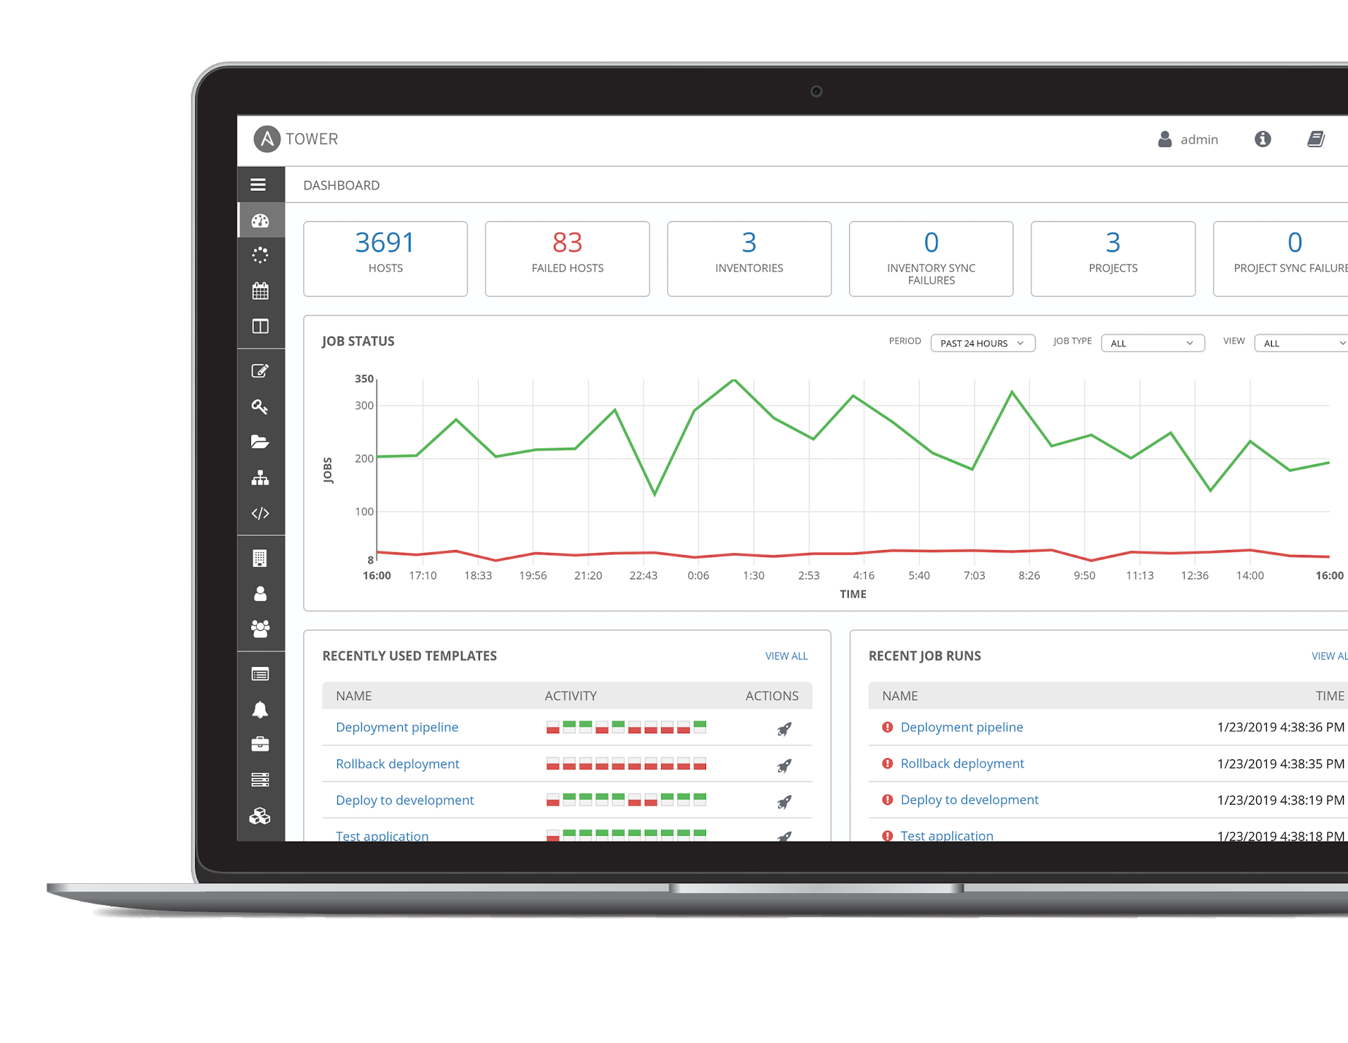
What is Ansible Tower?
Ansible Tower is a UI and RESTful API allowing you to scale IT automation, manage complex deployments and speed productivity.
• Role-based access control
• Deploy entire applications with push-button deployment access
• All automations are centrally logged
• Powerful workflows match your IT processes
Notes:
Control, Knowledge, Delegation
When more than one person is running the same playbook in the organization, Ansible Tower is valuable.
RBAC
Push button deployment (Delegation)
Centralized logging (auditing, compliance)
RESTful API
Role-based access control keeps environments secure, and teams efficient
Non-privileged users can safely deploy entire applications with push-button deployment access
All Ansible automations are centrally logged, ensuring complete auditability and compliance
Centralize and control your IT infrastructure with a visual dashboard, role-based access control, job scheduling, integrated notifications and graphical inventory management.

Slide 29
Red Hat Ansible Tower
Push button
RESTful API
RBAC
With an API first mentality every feature and function of Tower can be API driven. Allow seamless integration with other tools like ServiceNow and Infoblox.
Allow restricting playbook access to authorized users. One team can use playbooks in check mode (read-only) while others have full administrative abilities.
An intuitive user interface experience makes it easy for novice users to execute playbooks you allow them access to.
Enterprise integrations
Centralized logging
Workflows
Integrate with enterprise authentication like TACACS+, RADIUS, Azure AD. Setup token authentication with OAuth 2. Setup notifications with PagerDuty, Slack and Twilio.
All automation activity is securely logged. Who ran it, how they customized it, what it did, where it happened - all securely stored and viewable later, or exported through Ansible Tower’s API.
Ansible Tower’s multi-playbook workflows chain any number of playbooks, regardless of whether they use different inventories, run as different users, run at once or utilize different credentials.
Notes:
WORKFLOWS
Ansible Tower’s multi-playbook workflows chain any number of playbooks, regardless of whether they use different inventories, run as different users, run at once or utilize different credentials.

Slide 30







Ansible Automation Platform
….
ANSIBLE CLI & CI SYSTEMS
ADMINS
ANSIBLE PLAYBOOKS
ANSIBLE TOWER
CLOUD.REDHAT.COM
ROLE-BASED
ACCESS CONTROL
KNOWLEDGE & VISIBILITY
SCHEDULED &
CENTRALIZED JOBS
AUTOMATION
HUB
CERTIFIED COLLECTIONS
SIMPLE USER INTERFACE
TOWER API
PARTNER COLLECTIONS
USERS
AUTOMATION
ANALYTICS
ANSIBLE
ENGINE
PERFORMANCE DASHBOARD
OPEN SOURCE MODULE LIBRARY
PLUGINS
PYTHON CODEBASE
ORGANIZATIONAL STATS
TRANSPORT SSH, WINRM, NETWORK_CLI, HTTPAPI
AUTOMATE YOUR ENTERPRISE
INFRASTRUCTURE
LINUX,
OPENSHIFT,
WINDOWS,
VMWARE,
OPERATORS,
CONTAINERS …
NETWORK
ARISTA, CISCO, JUNIPER
INFOBLOX
F5 …
SECURITY
CHECKPOINT,
QRADAR,
SNORT
CYBERARK,
SPLUNK,
FORTINET …
CLOUD
AWS, GOOGLE CLOUD, AZURE,
IBM CLOUD …
SERVICES
DATABASES,
LOGGING, SOURCE CONTROL MANAGEMENT…
APP DEVELOPMENT
PYTHON VENV,
NPM, YUM,
APT, PIP...
USE CASES
PROVISIONING
CONFIGURATION
MANAGEMENT
APP DEPLOYMENT
CONTINUOUS DELIVERY
SECURITY & COMPLIANCE
ORCHESTRATION
Notes:
WORKFLOWS
Ansible Tower’s multi-playbook workflows chain any number of playbooks, regardless of whether they use different inventories, run as different users, run at once or utilize different credentials.

Slide 31
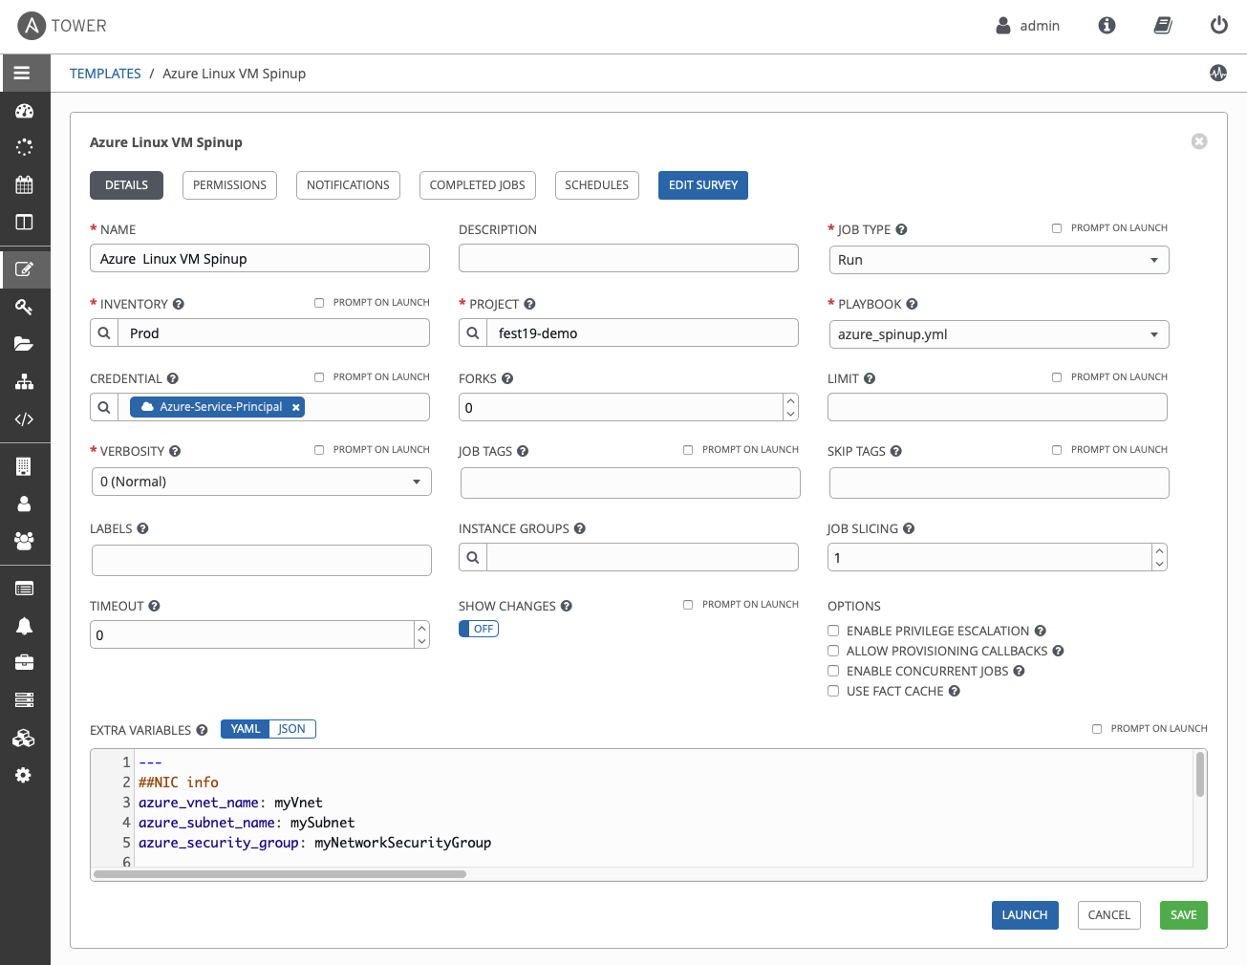
Job Templates
Everything in Ansible Tower revolves around the concept of a Job Template. Job Templates allow Ansible Playbooks to be controlled, delegated and scaled for an organization. Job templates also encourage the reuse of Ansible Playbook content and collaboration between teams.
A Job Template requires:
An Inventory to run the job against
A Credential to login to devices.
A Project which contains Ansible Playbooks

Slide 32
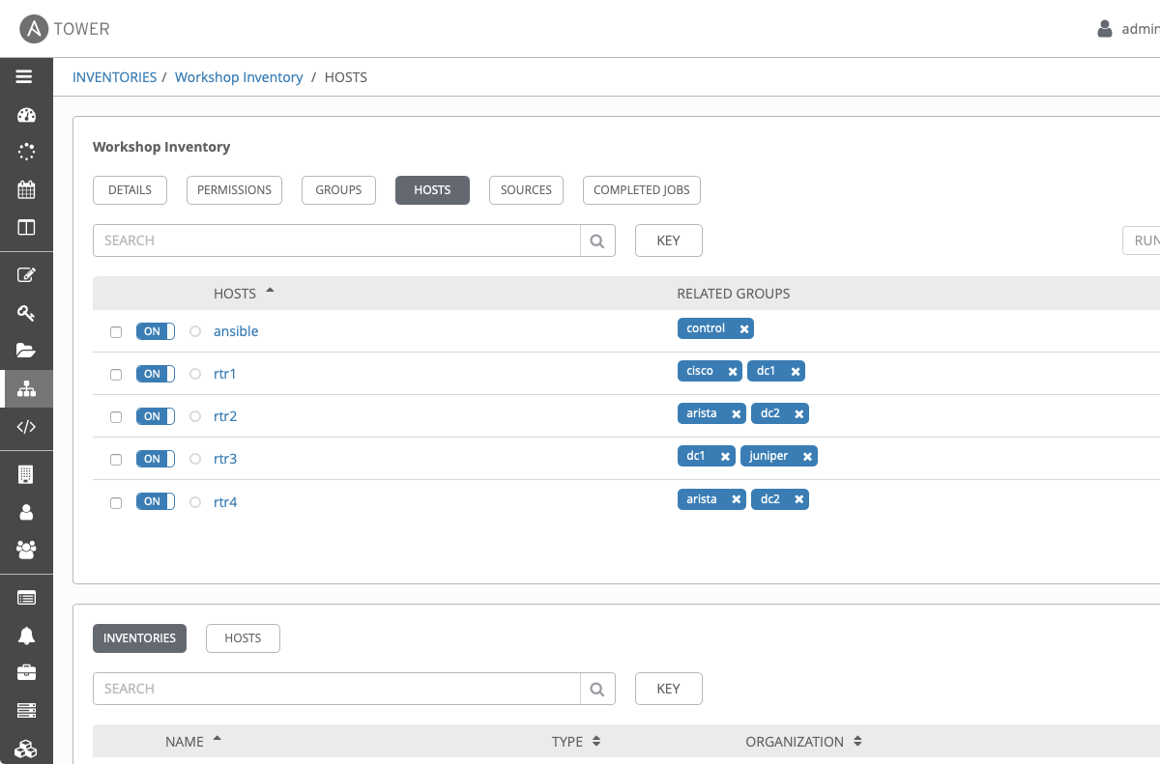
Inventory
Inventory is a collection of hosts (nodes) with associated data and groupings that Ansible Tower can connect to and manage.
Hosts (nodes)
Groups
Inventory-specific data (variables)
Static or dynamic sources
Notes:
An Inventory is a collection of hosts against which jobs may be launched, the same as an Ansible inventory file. Inventories are divided into groups and these groups contain the actual hosts. Groups may be sourced manually, by entering host names into Tower, or from one of Ansible Tower’s supported cloud providers.
Ansible Tower inventory is identical in behavior to the Ansible Engine cli. In fact for the workshop we used one command to import the workshop INI file into Ansible Tower. Check out this blog for more info: https://www.ansible.com/blog/three-quick-ways-to-move-your-ansible-inventory-into-red-hat-ansible-tower

Slide 33
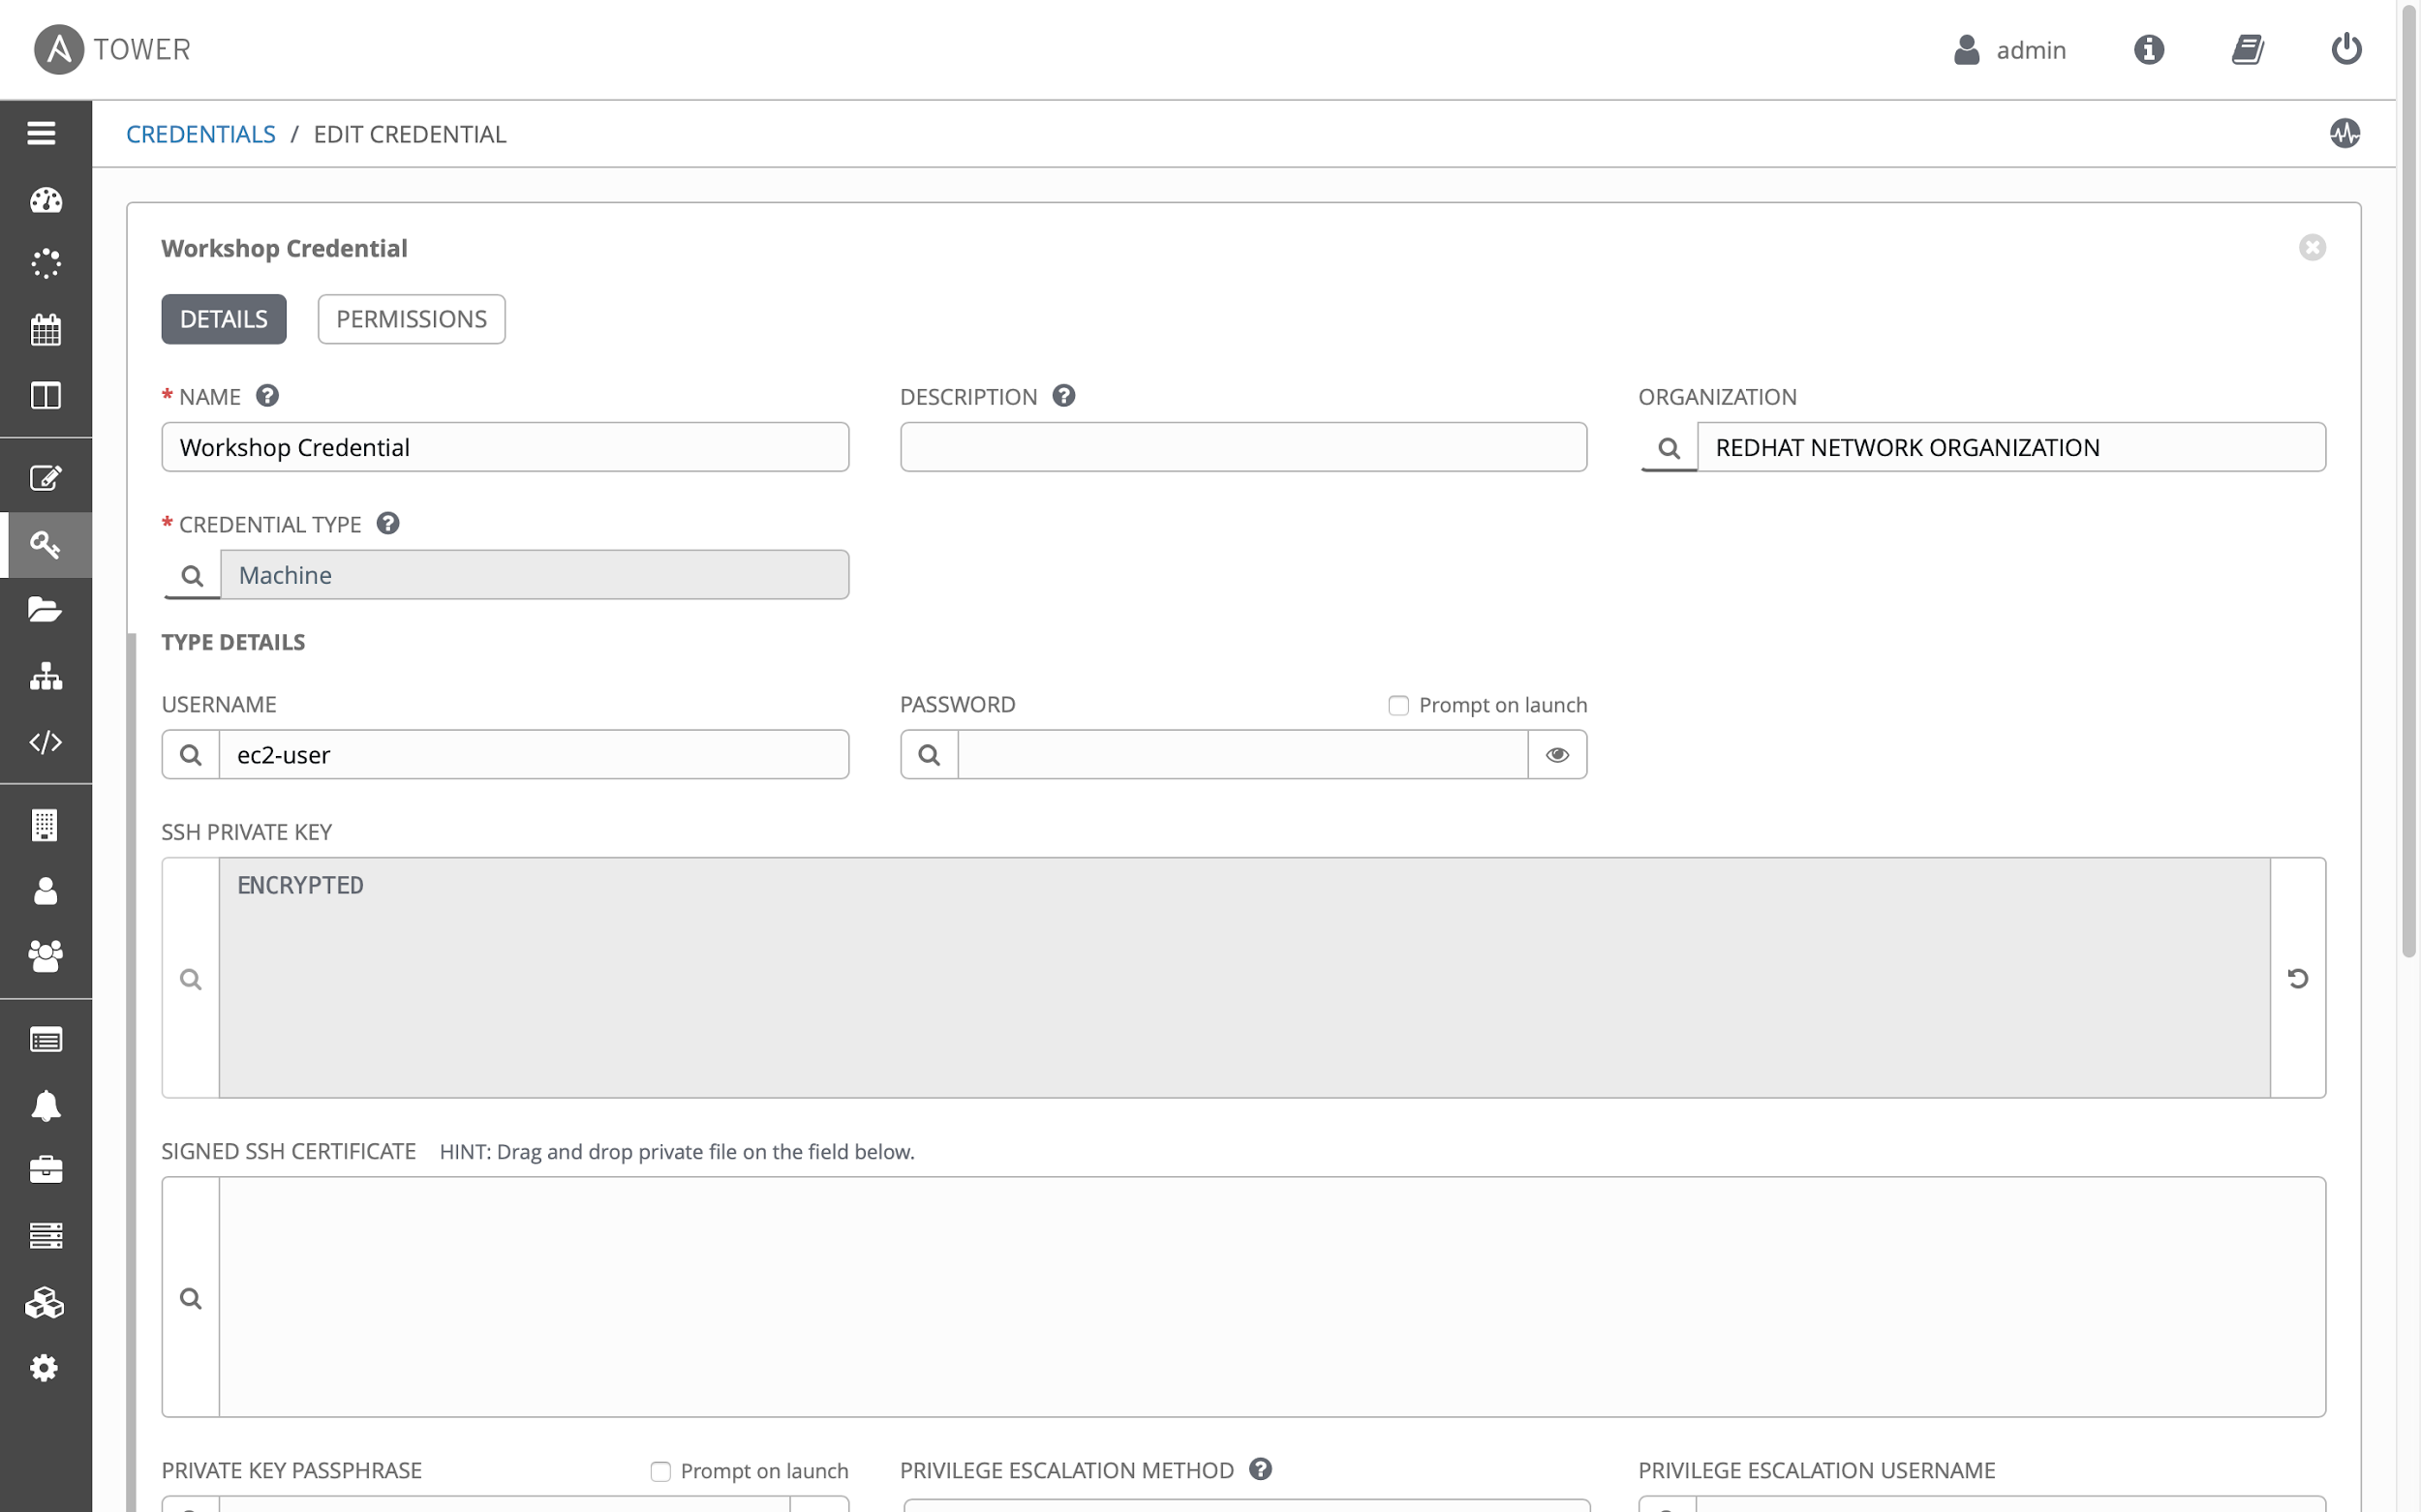
Credentials
Credentials are utilized by Ansible Tower for authentication with various external resources:
Connecting to remote machines to run jobs
Syncing with inventory sources
Importing project content from version control systems
Connecting to and managing network devices
Centralized management of various credentials allows end users to leverage a secret without ever exposing that secret to them.
Notes:
Credentials can be a plain text password, an SSH key, a token or whatever the automated endpoint needs for authentication. Red Hat Ansible Tower includes integrations with existing credential management tools such as HashiCorp Vault and CyberArk

Slide 34
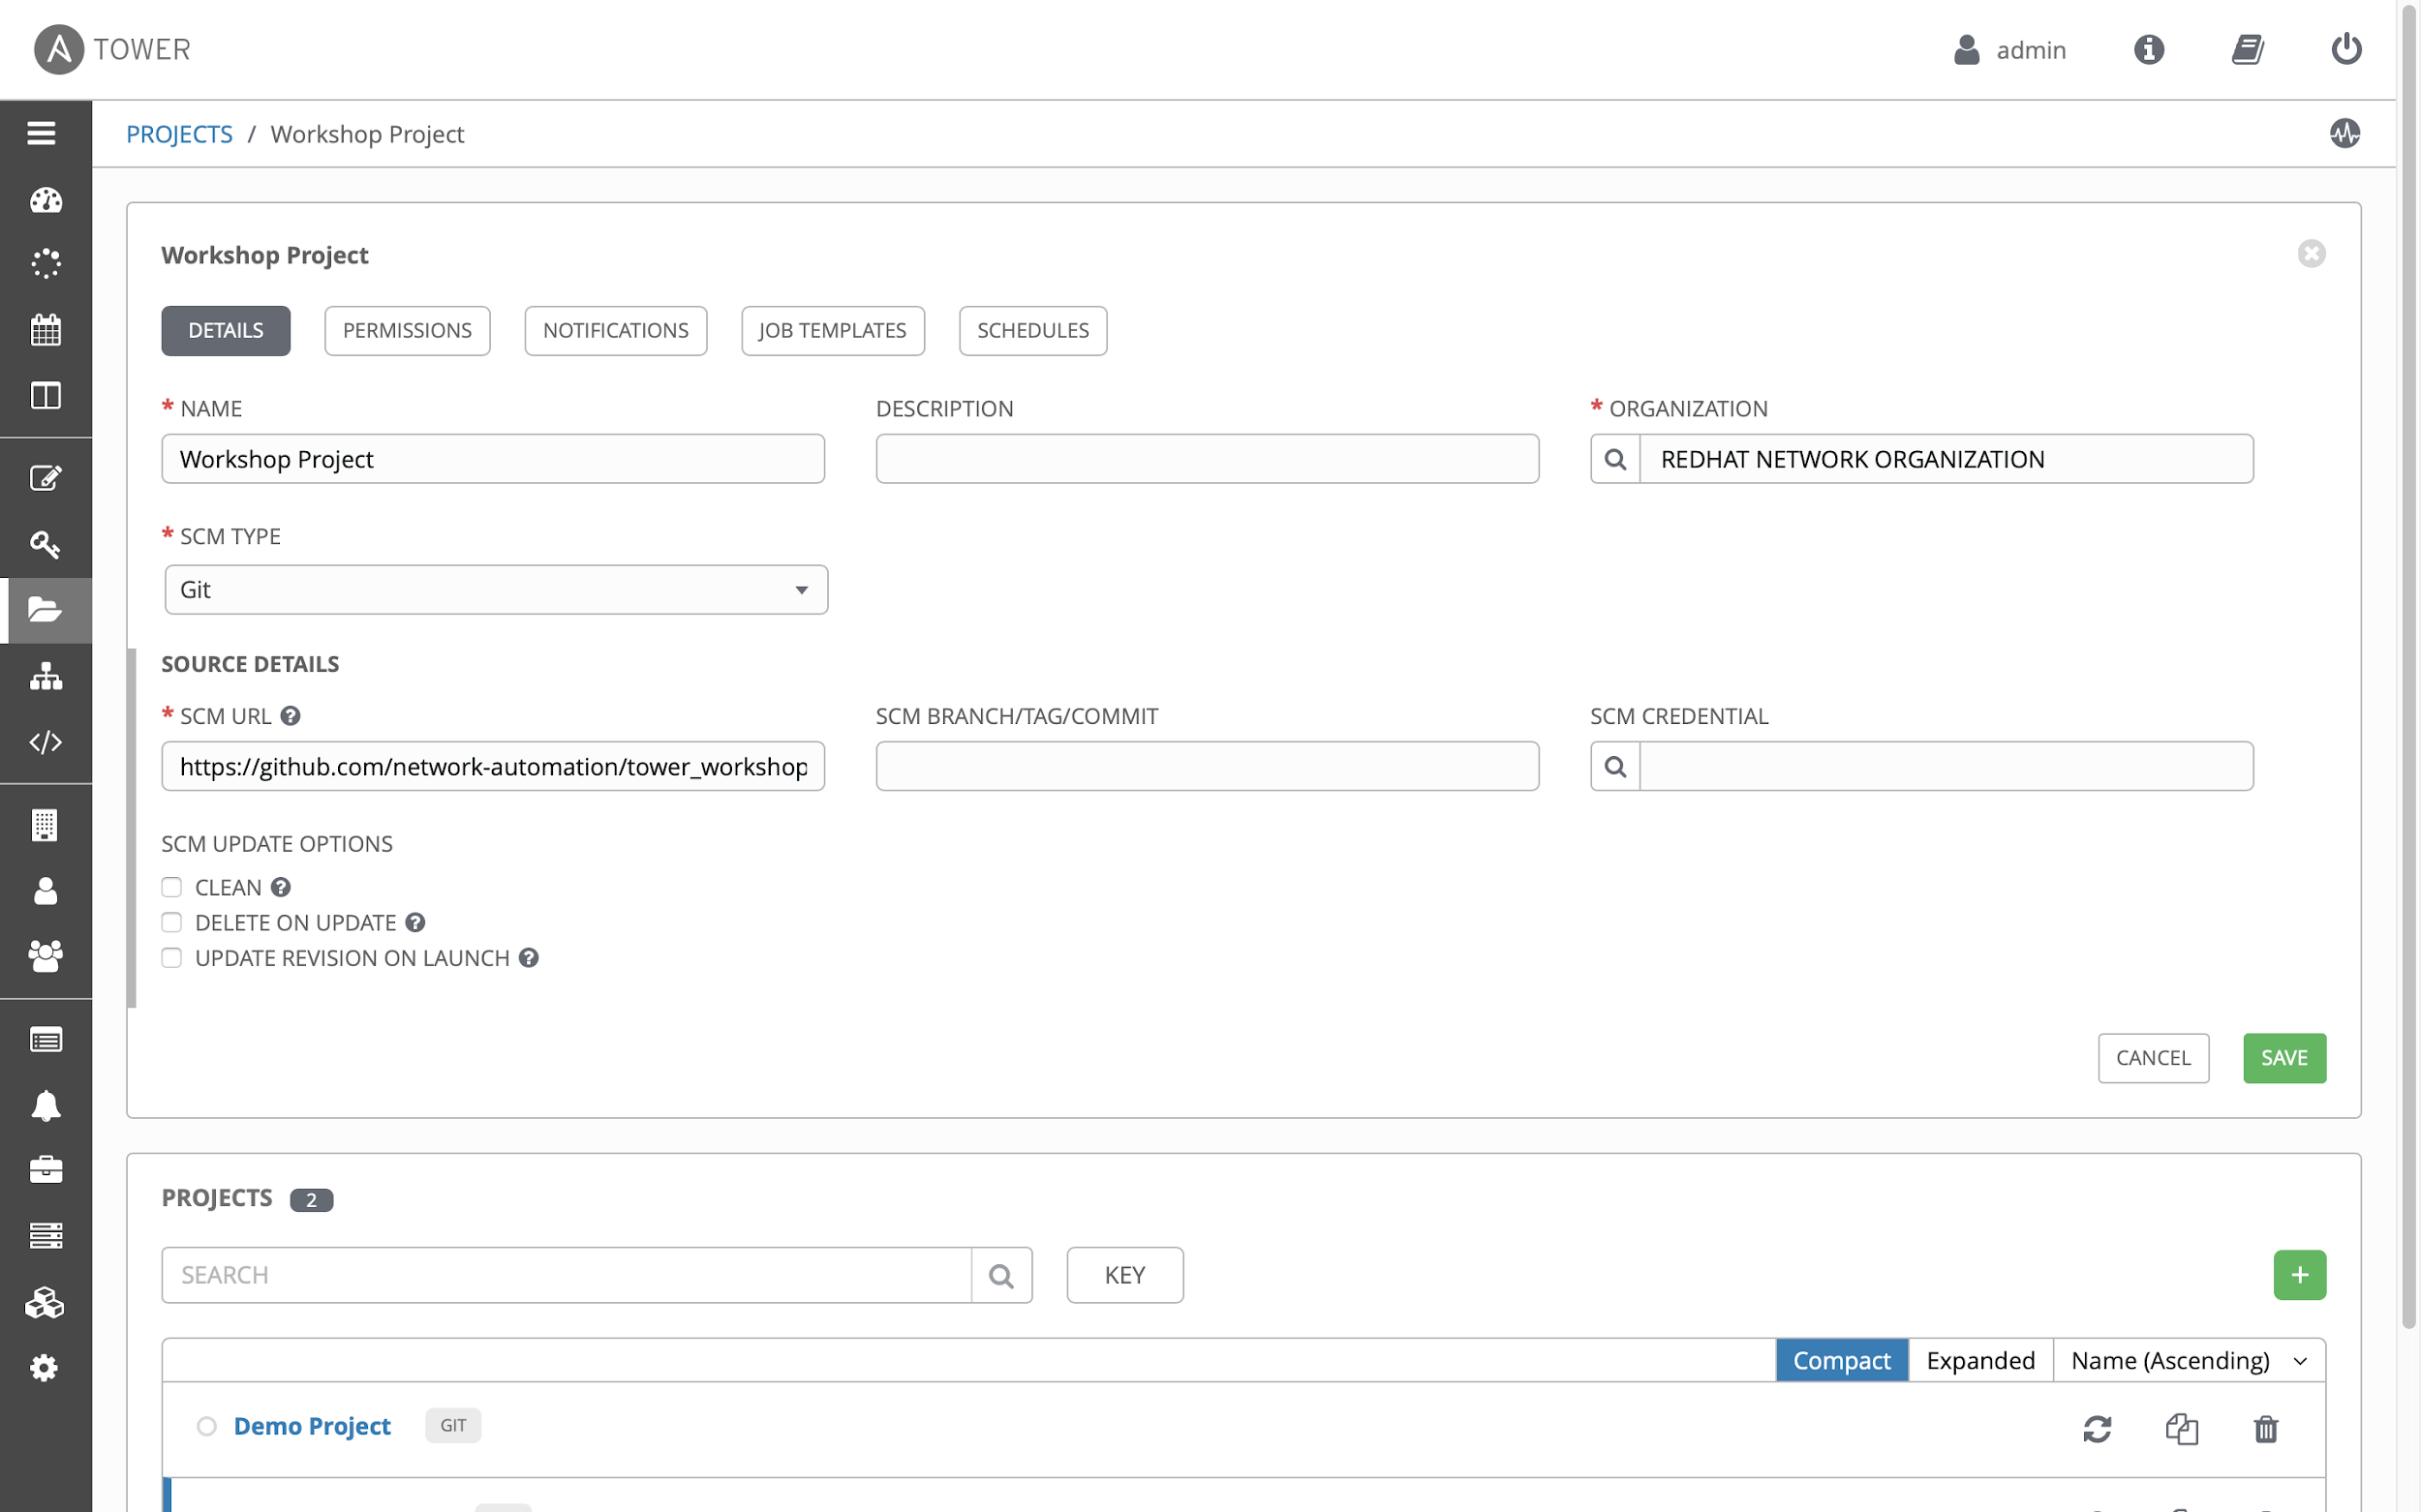
Project
A project is a logical collection of Ansible Playbooks, represented in Ansible Tower.
You can manage Ansible Playbooks and playbook directories by placing them in a source code management system supported by Ansible Tower, including Git, Subversion, and Mercurial.

Slide 35
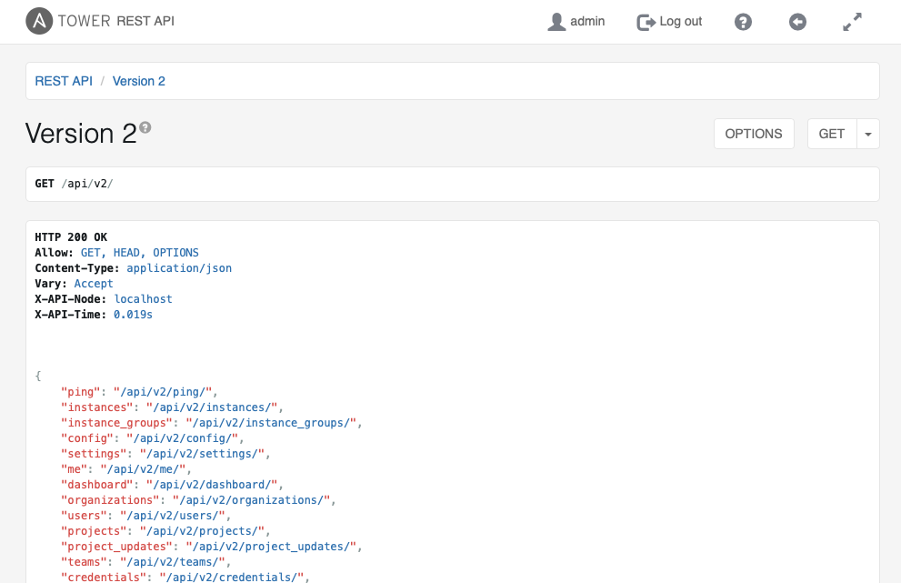
RESTful API
Fully browsable API, everything within the Web UI can be accessed via the API for programmatic access
This structured JSON output contains clickable links

Slide 36
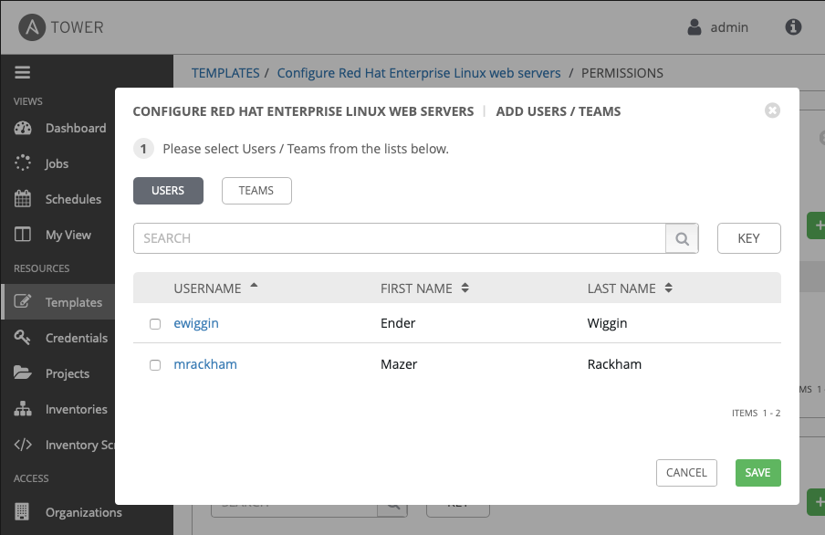
Role Based Access Control (RBAC)
Job Templates, Inventory, Credentials and Projects can be assigned to specific Users and Teams.
Clicking the USERS or TEAMS buttons shows available options
Notes:
If you want to give any user or team permissions to use a job template, just assign permissions directly on the job template. Similarly, credentials are full objects in Tower’s RBAC system, and can be assigned to multiple users and/or teams for use.
A new ‘Auditor’ type has been introduced in Tower as well, who can see all aspects of the systems automation, but has no permission to run or change automation, for those that need a system-level auditor.

Slide 37
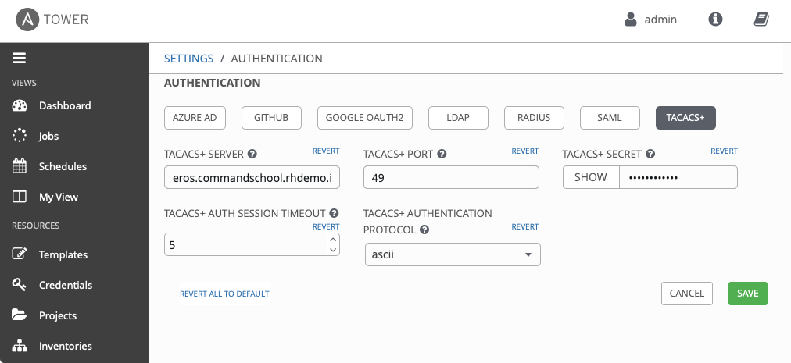
Enterprise Authentication
Multiple supported enterprise authentication methods are easily integrated with Ansible Tower
Use your existing enterprise authentication including:
• Azure AD • Github • Google OAuth2 • LDAP • Radius • SAML • TACACS+
Notes:
We know that Ansible Tower has to work with existing IT infrastructure. Why reinvent the wheel for credential management or authentication methods? Ansible Tower contains multiple enterprise authentication methods including Azure AD, Github, Google OAuth2, LDAP, Raidus, SAML and TACACS+.

Slide 38
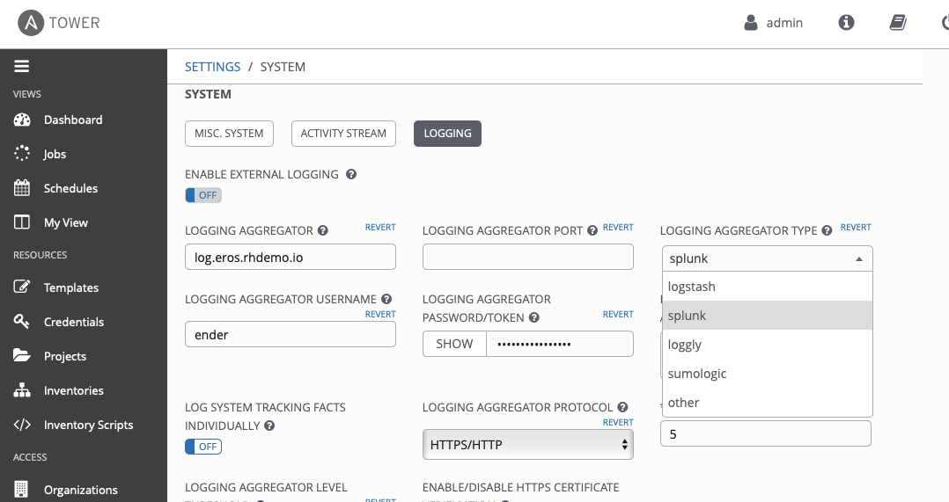
Centralized Logging
Ansible Tower creates a centralized control point for Ansible Automation. If desired Ansible Tower can integrated with existing log aggregation services.
Multiple supported 3rd party external logging methods are easily integrated with Ansible Tower
Notes:
Logging provides the capability to send detailed logs to several kinds of 3rd party external log aggregation services. Services connected to this data feed serve as a useful means in gaining insight into Tower usage or technical trends. The data can be used to analyze events in the infrastructure, monitor for anomalies, and correlate events from one service with events in another. The types of data that are most useful to Tower are job fact data, job events/job runs, activity stream data, and log messages. The data is sent in JSON format over a HTTP connection using minimal service-specific tweaks engineered in a custom handler or via an imported library. Tower discards any uncaptured data if the logging aggregator is down.

Slide 39
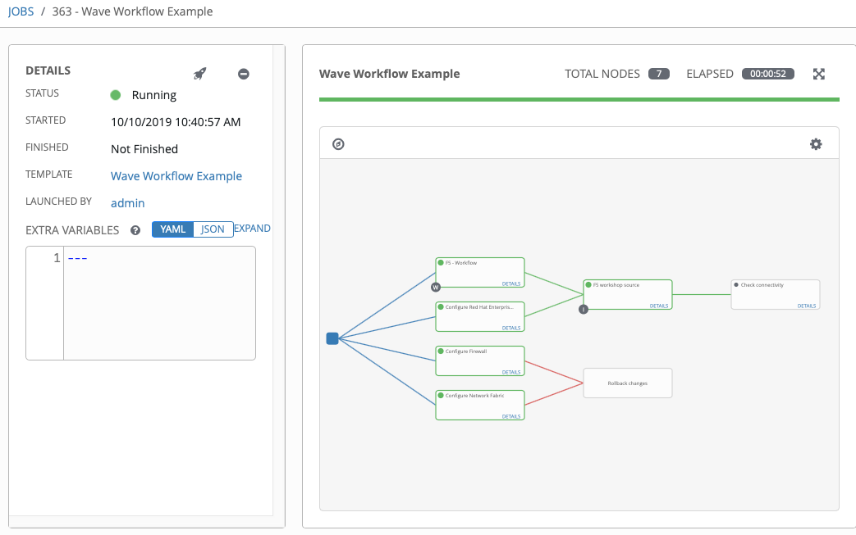
Workflows
Create powerful holistic automation using Ansible Workflows.
Orchestration can easily be configured by linking Job Templates.
Workflow approvals allow Workflows to pause and wait for human interaction
Flow logic can be applied to workflows. If this job fails this next Job is run!
Notes:
Workflows allow you to configure a sequence of disparate job templates (or workflow templates). Job or workflow templates are linked together using a graph-like structure called nodes. These nodes can be jobs, project syncs, or inventory syncs. A template can be part of different workflows or used multiple times in the same workflow.

Slide 40




Webhooks - Enabling GitOps
Trigger Job Templates or Workflows straight via configurable webhooks Automatically provision, update, configure, and apply based on pushes to your source control.
Notes:
With Tower 3.6 and newer there is now configurable webhooks. This is tied strictly to Github or Gitlab to make infrastructure as a code easier and intuitive for customers without requiring yet another tool such as jenkins.

Slide 41
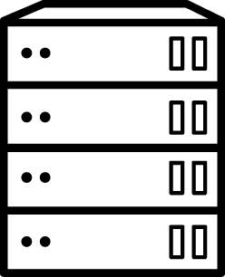

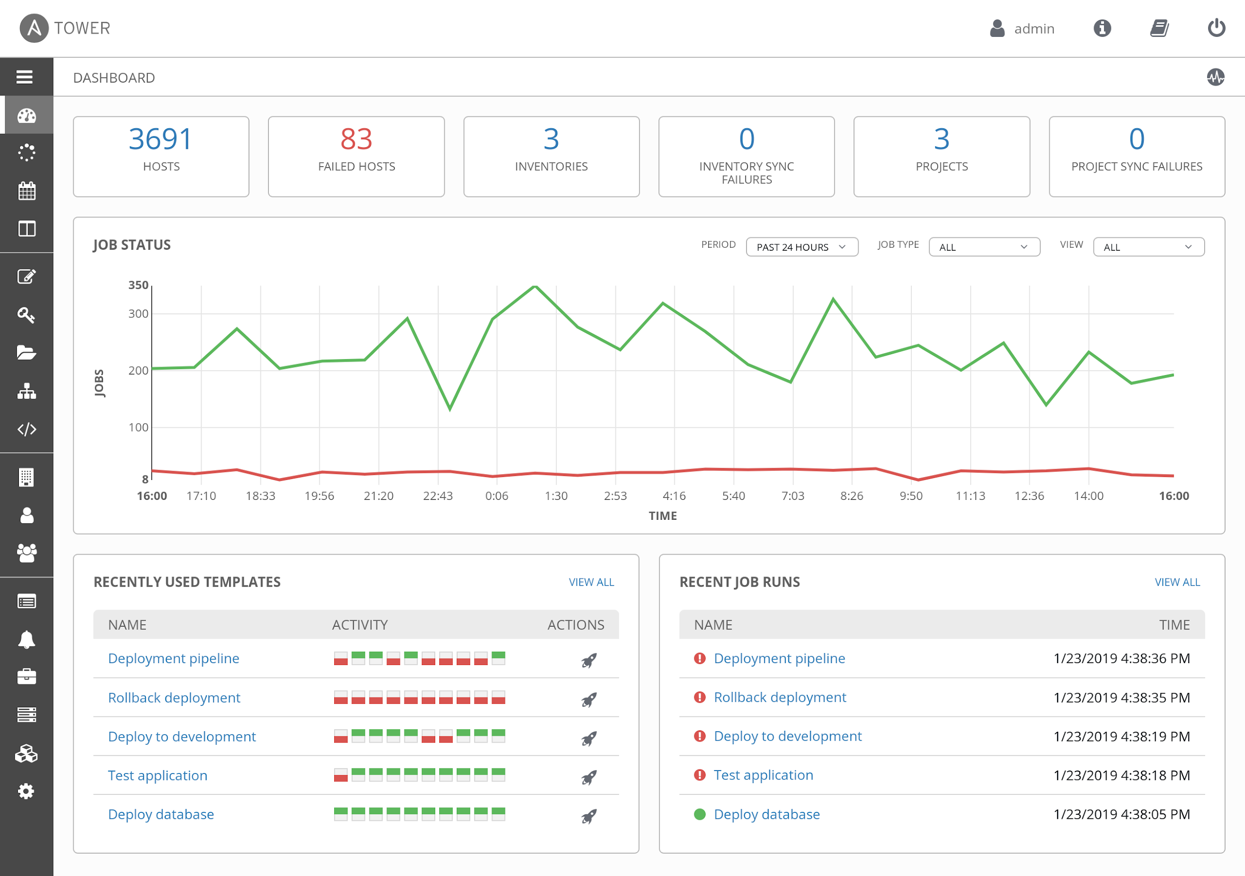
Scale
Ansible Tower
Ansible Tower clusters add redundancy and capacity, allowing you to scale Ansible automation across your enterprise.
Unifying task execution across execution nodes
Leverage Kubernetes and OpenShift to spin up execution capacity at runtime
Expand execution to be able to pull jobs from a central Ansible Tower infrastructure
Notes:
Connect multiple Ansible Tower nodes into a Ansible Tower cluster. Ansible Tower clusters add redundancy and capacity, allowing you to scale Ansible automation across your enterprise, including with reserved capacity for certain teams and jobs, and remote execution for access across network zones. Current Ansible Automation architecture can scale to 200K nodes with 20 cluster nodes.

Slide 42
CLOUD.REDHAT.COM
Engage users with an automation focused experience

Slide 43
Red Hat Ansible Automation Platform
Network
Lines of business
Security
Operations
Infrastructure
Developers
Engage
Knowledge
Automation Analytics
Collaborate
Automation Hub
Governance
Automation Services Catalog
Trusted
Certified content
Accelerate
Collections
Scale
Ansible Tower: Operate & control at scale
Create
Ansible Engine: Universal language of automation
Fueled by an open source community
Notes:
Ansible Automation is the enterprise framework for automating across IT operations.
Ansible Engine runs Ansible Playbooks, the automation language that can perfectly describe an IT application infrastructure.
Ansible Tower allows you scale IT automation, manage complex deployments and speed productivity.
Ansible is the Lingua Franca of the enterprise
It empowers development to production, from IT to the business
----------------------------------------------------------------
Points Tim Yeaton added here in his delivery:
memorialize/institutionalize in the Playbook
Standardize on Ansible
You need a language to help articulate the workflow all they way through live production
Use a language to communicate and facilitate between dev and ops
Becomes fact based or system of record once written in a Playbook

Slide 44



Automation Analytics: What is it?
SaaS (Software as a Service) on cloud.redhat.com
Analytics for all Ansible Tower clusters for an organization
Includes:
• visual dashboard
• health notifications
• organization statistics
Notes:
Workflows allow you to configure a sequence of disparate job templates (or workflow templates). Job or workflow templates are linked together using a graph-like structure called nodes. These nodes can be jobs, project syncs, or inventory syncs. A template can be part of different workflows or used multiple times in the same workflow.

Slide 45

Automation Analytics: What does it provide?
Enables an Automation Center of Excellence
View information about automation health, usage and performance across your enterprise.
Gain information about automation in your enterprise:
Which organizations are using the most automation?
Utilization rates
Enterprise-wide success and failure rates for automation
Notes:
Workflows allow you to configure a sequence of disparate job templates (or workflow templates). Job or workflow templates are linked together using a graph-like structure called nodes. These nodes can be jobs, project syncs, or inventory syncs. A template can be part of different workflows or used multiple times in the same workflow.

Slide 46
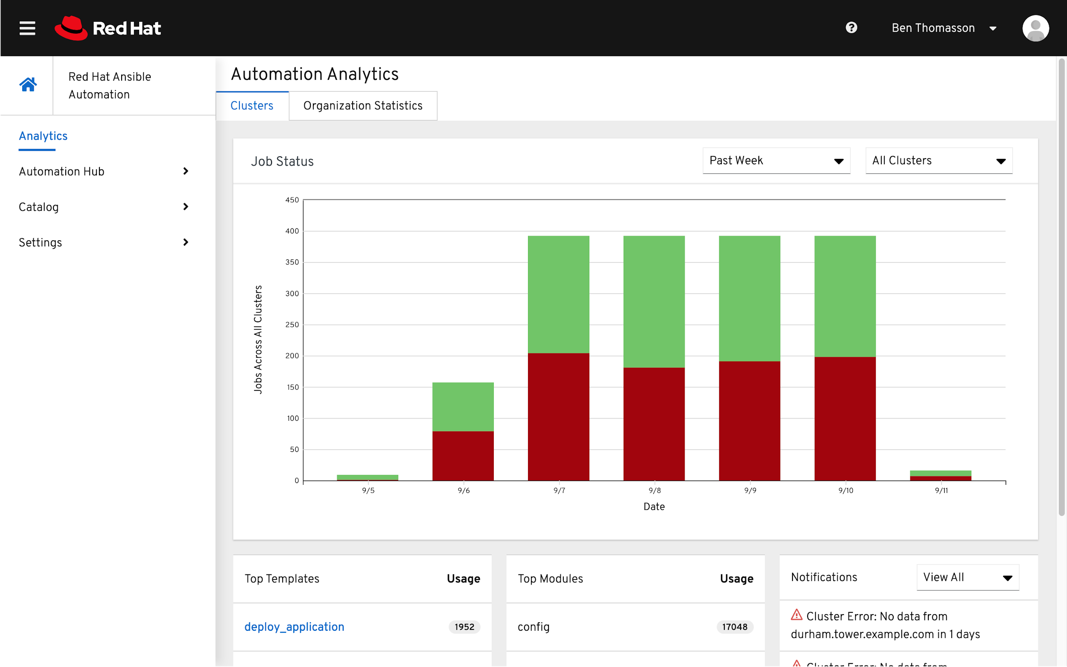
Analytics dashboard
Information across all clusters for an enterprise:
Job Status graph
Top Job Templates
Top Modules
Notes:
Workflows allow you to configure a sequence of disparate job templates (or workflow templates). Job or workflow templates are linked together using a graph-like structure called nodes. These nodes can be jobs, project syncs, or inventory syncs. A template can be part of different workflows or used multiple times in the same workflow.

Slide 47
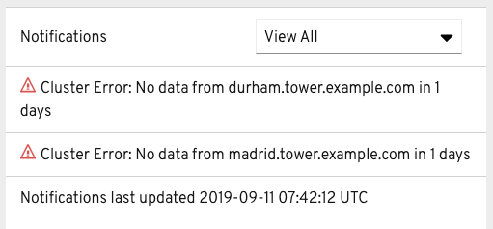
Health notifications
Ansible Tower Cluster is down
Node (within a cluster) is down
Last time data was updated
Near license count
Notes:
Workflows allow you to configure a sequence of disparate job templates (or workflow templates). Job or workflow templates are linked together using a graph-like structure called nodes. These nodes can be jobs, project syncs, or inventory syncs. A template can be part of different workflows or used multiple times in the same workflow.

Slide 48
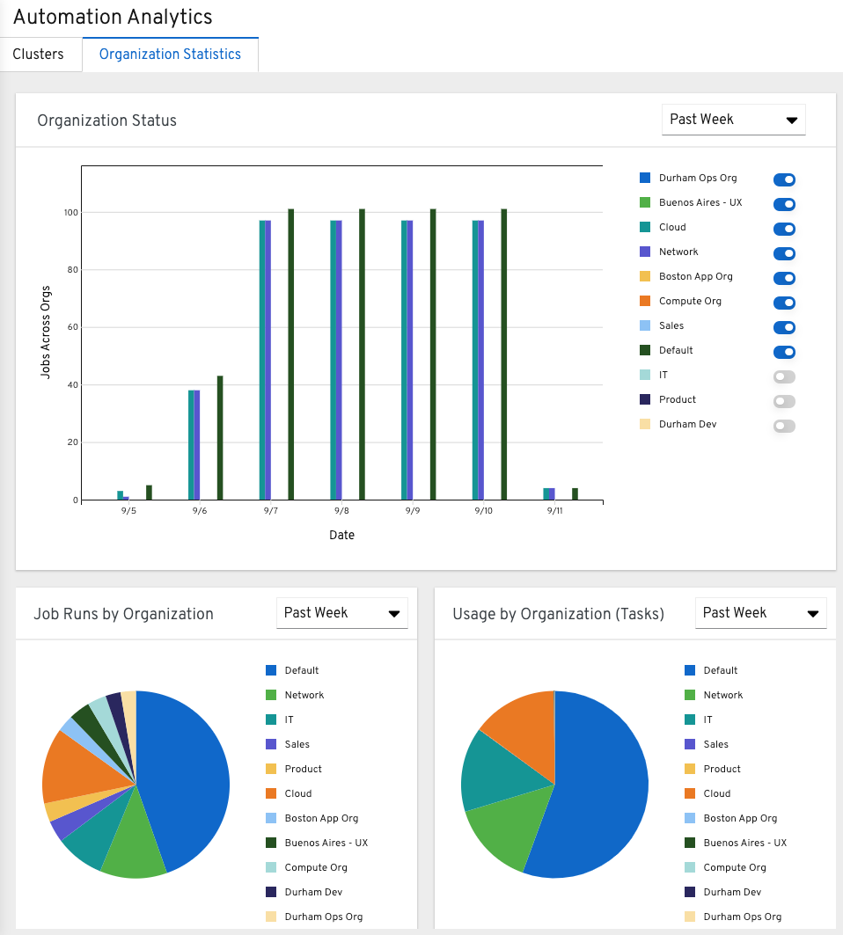
Organizational statistics
Filter by Organization
Job Status by Organization
Usage by Organization
Job Runs by Organization
Notes:
Organizational statistics allows a customer to see Ansible consumption across an enterprise. If one organization starts producing Ansible Job Templates and shares them across their company, data is aggregated and presented in a visual format to show trends over time. This data can be filters by organization, and filtered over time to present usual data to compare organizations against each other. What we saw with several large customers was that they wanted to be able to measure success and were starting to aggregate this data manually anyway, so we want to make this process more turn-key and easy for all customers to help give them the ability to measure success.

Slide 49
Dashboard comparison
Ansible Tower
Automation Analytics
• Recent job templates • No module data
• One cluster
• Top job templates
• Top modules
• All clusters • Filter by cluster
Notes:
Organizational statistics allows a customer to see Ansible consumption across an enterprise. If one organization starts producing Ansible Job Templates and shares them across their company, data is aggregated and presented in a visual format to show trends over time. This data can be filters by organization, and filtered over time to present usual data to compare organizations against each other. What we saw with several large customers was that they wanted to be able to measure success and were starting to aggregate this data manually anyway, so we want to make this process more turn-key and easy for all customers to help give them the ability to measure success.

Slide 50


Simplified and consistent content delivery
Ansible Content Collections
Provides quick benefit by lowering barriers to automation
Streamlines tech partners providing direct-to-user automation
Simplifies internal collaboration, distribution, versioning
Ability to distribute, share and consume content at your own pace
Notes:
Ansible Content Collections, or collections, represent the new standard of distributing, maintaining and consuming automation. By combining multiple types of Ansible content (playbooks, roles, modules, and plugins), flexibility and scalability are greatly improved.
Traditionally, module creators have had to wait for their modules to be marked for inclusion in an upcoming Ansible release or had to add them to roles, which made consumption and management more difficult. By shipping modules within Ansible Content Collections along with pertinent roles and documentation, and removing the barrier to entry, creators are now able to move as fast as the demand for their creations. For a public cloud provider, this means new functionality of an existing service or a new service altogether, can be rolled out along with the ability to automate the new functionality.
For the automation consumer, this means that fresh content is continuously made available for consumption. Managing content in this manner also becomes easier as modules, plugins, roles, and docs are packaged and tagged with a collection version. Modules can be updated, renamed, improved upon; roles can be updated to reflect changes in module interaction; docs can be regenerated to reflect the edits and all are packaged and tagged together.
Before collections, it was not uncommon for modules to break or lack timely updates needed to interact with the services they were interfacing with. This often required Ansible users or Ansible Tower administrators to run multiple versions of Ansible in virtual environments in order to consume a patch that addressed a module issue. Ansible Content Collections bring stability and predictability by breaking modules out from the core distribution.
For automated organizations, this means that certified content is readily available to be applied to use-cases ripe for automation from day one.

Slide 51
Ansible Content Collection example
Directory Layout
In a playbook
.
├── galaxy.yml
├── plugins
│ ├── action
│ │ └── ping.py
│ ├── module_utils
│ │ └── pingutils.py
│ └── modules
│ └── ping.py
└── roles
├── ping_bootstrap
│ ├── defaults
│ ├── filters
│ ├── meta
│ ├── tasks
│ └── vars
└── ping_deploy
├── defaults
├── meta
└── tasks
hosts: somehosts
collections:
- custom.pinger
- redhat.open_ping
tasks:
- custom.pinger.ping:
- ansible.builtin.ping: # use only the ping packaged in core
- ansible.legacy.ping: # use core or library(etc)/ping.py
when: thing | custom.pinger.filter == 42
- ping: # searches collections “path” otherwise…
# still works, == ansible.legacy.ping:
Notes:
An Ansible Content Collection can be described as a package format for Ansible content:
This format has a simple, predictable data structure, with a straightforward definition:
docs/: local documentation for the collection
galaxy.yml: source data for the MANIFEST.json that will be part of the collection package
playbooks/: playbooks reside here
tasks/: this holds 'task list files' for include_tasks/import_tasks usage
plugins/: all ansible plugins and modules go here, each in its own subdir
modules/: ansible modules
lookups/: lookup plugins
filters/: Jinja2 filter plugins
connection/: connection plugins required if not using default
roles/: directory for ansible roles
tests/: tests for the collection's contens

Slide 52
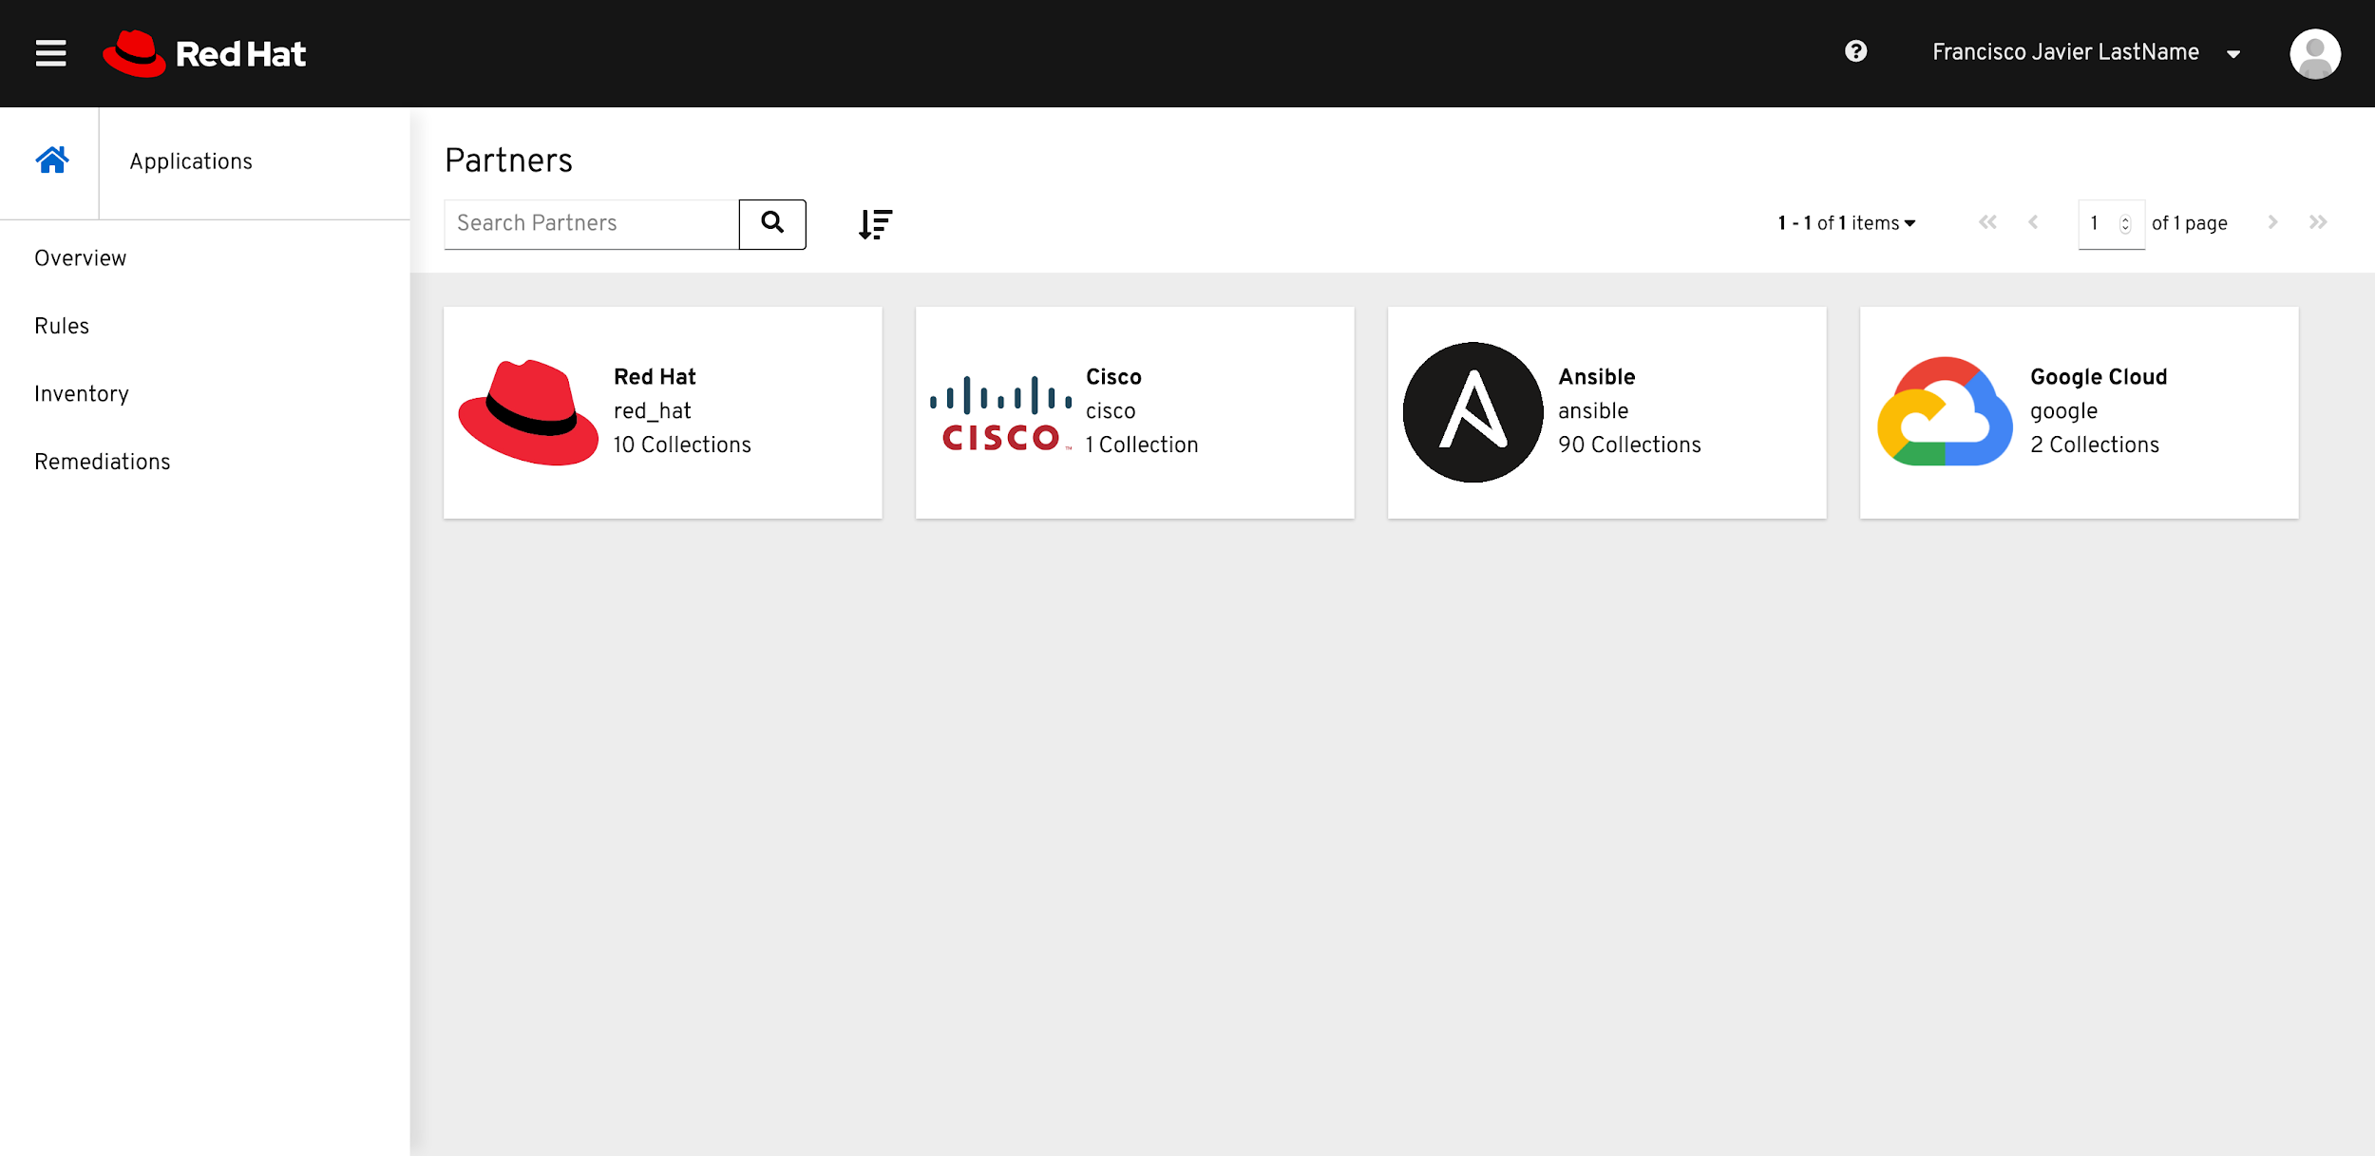
Discover, publish, and manage Collections
Automation Hub
Quickly discover available Red Hat and certified content through Collections.
Manage and test your organization’s view of available content.*
Publish your locally available automation via on-premise.*
Notes:
There’s a lot of automation in the world.
Content included in Ansible.
Content directly from vendors, including certified content from Red Hat’s partners.
20000 Ansible roles in Ansible Galaxy.
Plus all the playbooks and roles your 100 different development team have written internally.
It’s a lot to discover. It’s a lot to audit. It’s a lot to *manage*.
That’s why we’re introducing the Automation Hub - a new offering for subscribers.
The Automation Hub will surface to you the best content collections, from both Red Hat and from our certified partners.
Plus, subscribers will be able to manage their own content views, pulling from Red Hat, certified, community, and even managing their own internal automation sources via on-premise linking.

Slide 53

Manage, provision, and retire automation resources
Automation Services Catalog
Deliver customers’ pre built automation to the developer and the business user.
Deliver governance of automation services for the enterprise user.
Supply the necessary controls required by the business to track how this automation is being used.

Slide 54
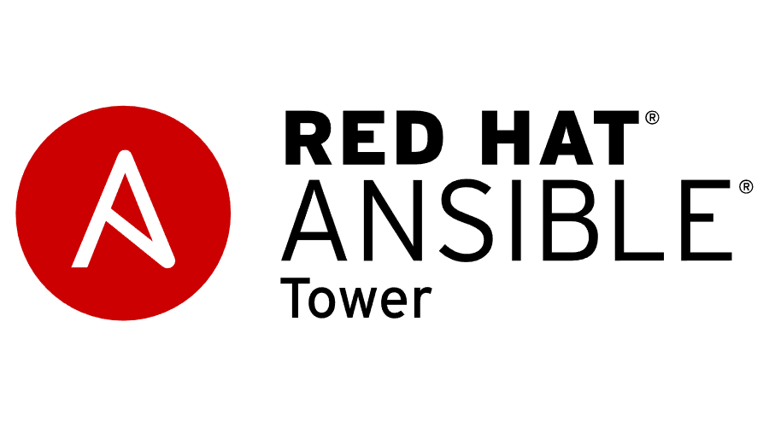



Interaction with the services catalog
Platforms
Portfolios
Ansible Tower is a Platform to the Catalog, it presents Job Templates and Workflows and executes them as jobs. Business governance can be applied to Platforms.
Allows for an Administrator to group service offerings as products into logical collections. Portfolios can be shared to groups of users as well as support Business Governance.
Products
Organizations
Users order Products are high level abstracts of the service offerings. An Administrator can override the detail of a Product as well as govern the individual product with Business Governance.
An Organization is a collection of Platforms, Portfolios, Products, Users, Groups and Approval policies. An entire organization can be governed for Business Logic.

Slide 55
Next steps:
Get started
Join the community
ansible.com/community
ansible.com/get-started ansible.com/tower-trial
Workshops, training & services
Share your story
ansible.com/workshops
Red Hat Training
Red Hat Services: Automation Adoption Journey
Follow us @Ansible
Friend us on Facebook
Notes:
So - where to go next? There are multiple ways you can follow on your onward going automation journey.
Get started right away with some intro and a trial for our Tower. If you want to get more serious about Ansible, take one of our available workshops, get formal training or contact our services team to adopt Ansible to your production challenges.
And: Ansible is a huge community. So share your thoughts and experiences, share your code and what you automate!

Slide 56
Thank you

Slide 57
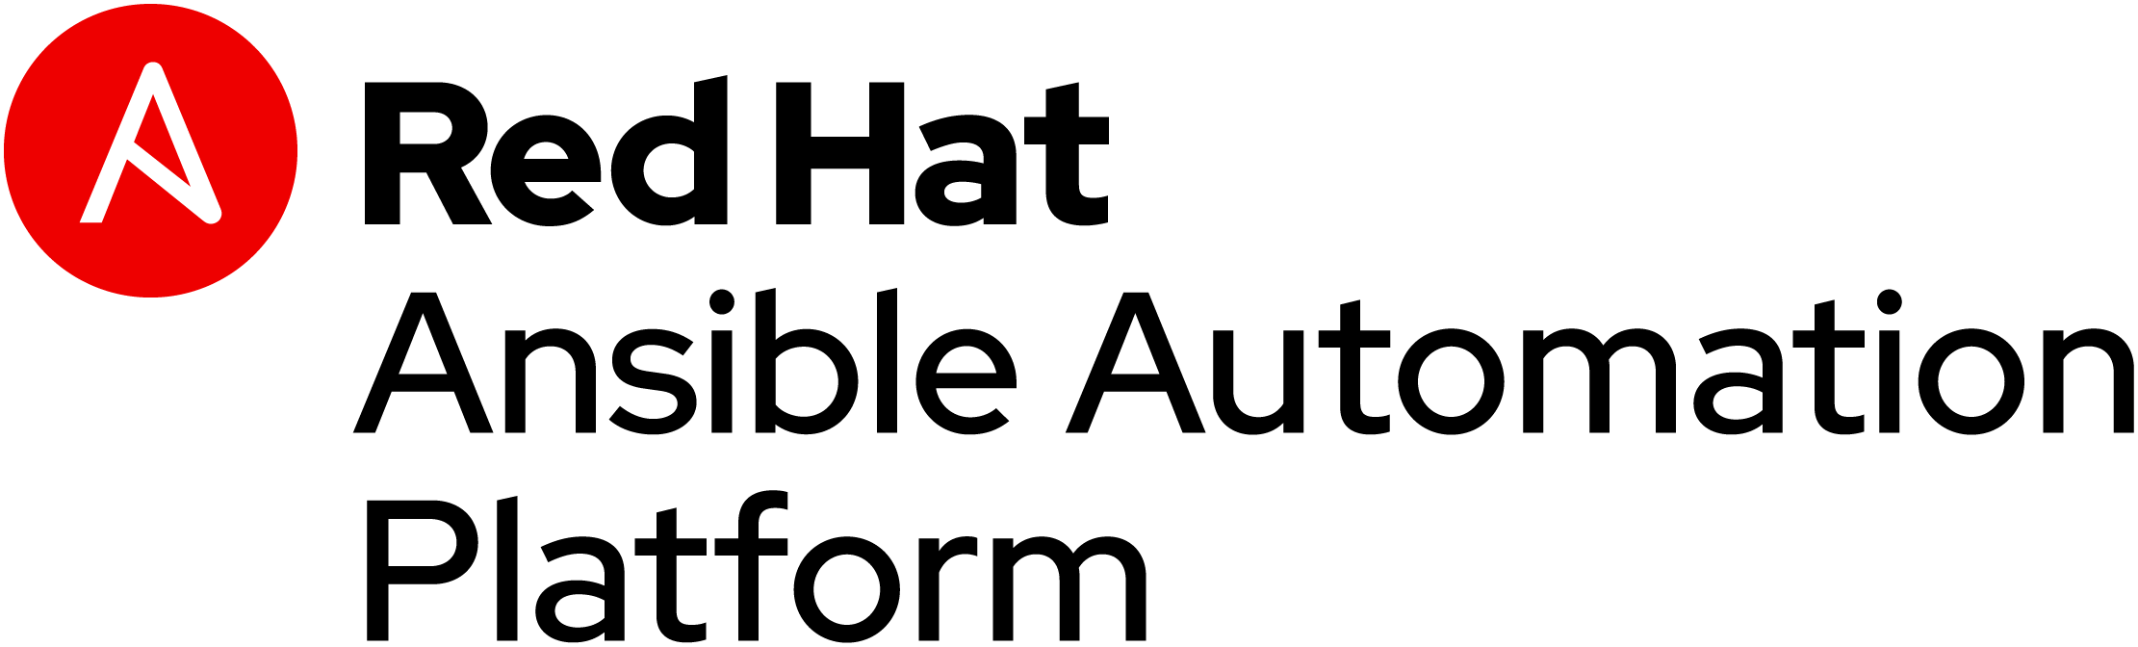
Strategic Use Cases
Notes:
Additional slides are here to help with specific use-cases for customers. These include automation for linux, networks, security, cloud and windows. Please provide feedback to the Ansible Marketing team at ansible-pmm-tmm@redhat.com

Slide 58


USE CASE: LINUX AUTOMATION

Slide 59
LINUX AUTOMATION
150+
Linux Modules
AUTOMATE EVERYTHING LINUX Red Hat Enterprise Linux, BSD, Debian, Ubuntu and many more!
ONLY REQUIREMENTS:
Python 2 (2.6 or later) or Python 3 (3.5 or later)
ansible.com/get-started
Notes:
60+ System Modules - https://docs.ansible.com/ansible/latest/modules/list_of_system_modules.html
50+ Packaging Modules - https://docs.ansible.com/ansible/latest/modules/list_of_packaging_modules.html
20+ File Modules - https://docs.ansible.com/ansible/latest/modules/list_of_files_modules.html
7+ Command Modules - https://docs.ansible.com/ansible/latest/modules/list_of_commands_modules.html
10+ Clustering Modules https://docs.ansible.com/ansible/latest/modules/list_of_clustering_modules.html
Automate every task and process on Linux
Managed nodes requirements: https://docs.ansible.com/ansible/latest/installation_guide/intro_installation.html#managed-node-requirements

Slide 60
AUTOMATION FOR EVERYONE: SYSTEM ADMINISTRATORS
---
- name: upgrade rhel packages
hosts: rhel
tasks:
- name: upgrade all packages
yum:
name: '*'
state: latest

Slide 61
AUTOMATION FOR EVERYONE: SYSTEM ADMINISTRATORS
---
- name: reboot rhel hosts
hosts: rhel
tasks:
- name: reboot the machine
reboot:

Slide 62
AUTOMATION FOR EVERYONE: SYSTEM ADMINISTRATORS
---
- name: check services on rhel hosts
hosts: rhel
become: yes
tasks:
- name: ensure nginx is started
service:
name: nginx
state: started

Slide 63
USE CASE: NETWORK AUTOMATION

Slide 64
ANSIBLE NETWORK AUTOMATION
65+
Network Platforms
1000+
Network Modules
ansible.com/for/networks
Notes:
Ansible Network modules comprise 1/3 of all modules that ship with Ansible Engine.

Slide 65
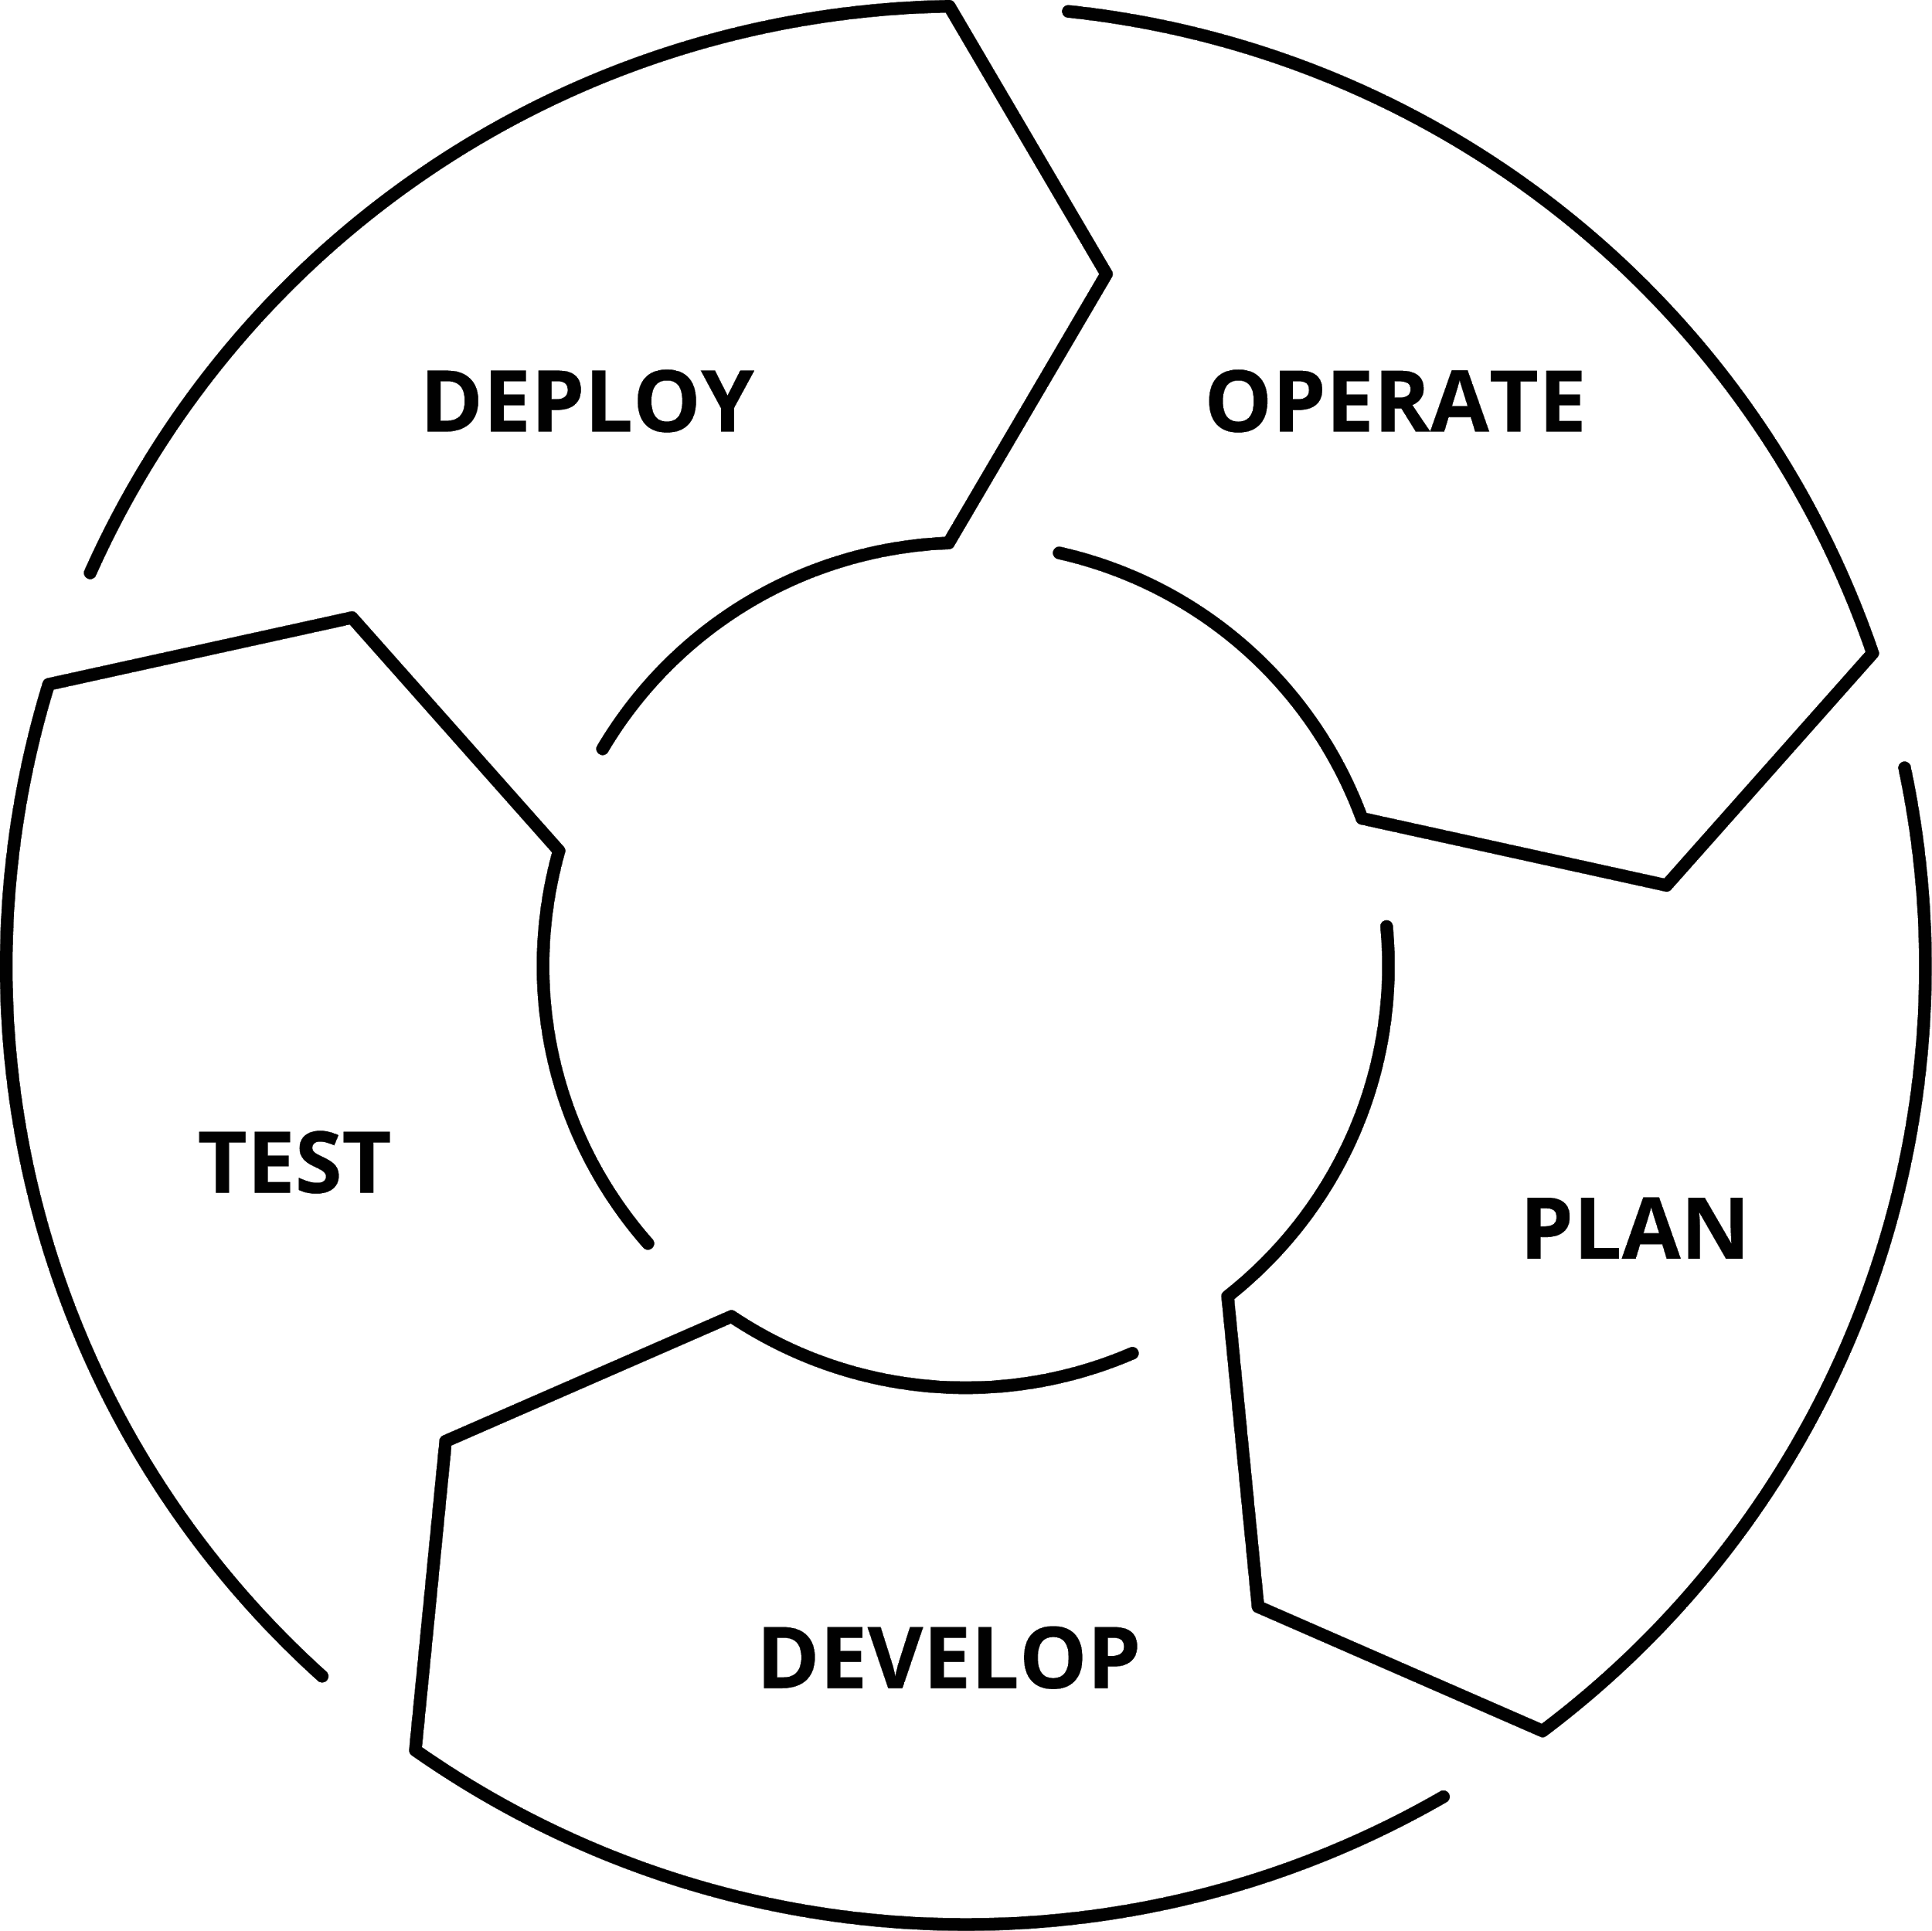

WHY AUTOMATE YOUR NETWORK?
PLAN AND PROTOTYPE VIRTUALLY
Use tasks as reusable building blocks
USE YOUR CURRENT DEVELOPMENT PRACTICES
Agile, DevOps, Waterfall
GO BEYOND THE “PING” TEST
Integrate with formal testing platforms
BE CONFIDENT DURING DEPLOYMENT
Validate changes were successful
ENSURE AN ON-GOING STEADY-STATE
Configure management at scale

Slide 66
AUTOMATION FOR EVERYONE: NETWORK ENGINEERS
---
- hosts: cisco
gather_facts: false
connection: network_cli
tasks:
- name: show command for cisco
cli_command:
command: show ip int br
register: result
- name: display result to terminal window
debug:
var: result.stdout_lines

Slide 67
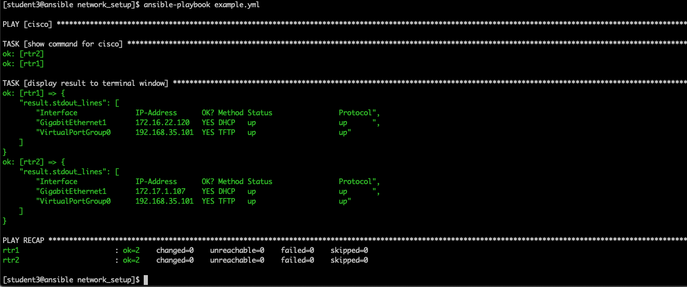
AUTOMATION FOR EVERYONE: PLAYBOOK RESULTS

Slide 68
AUTOMATION FOR EVERYONE: NETWORK ENGINEERS
---
- hosts: juniper
gather_facts: false
connection: network_cli
tasks:
- name: show command for juniper
cli_command:
command: show interfaces terse em1
register: result
- name: display result to terminal window
debug:
var: result.stdout_lines

Slide 69
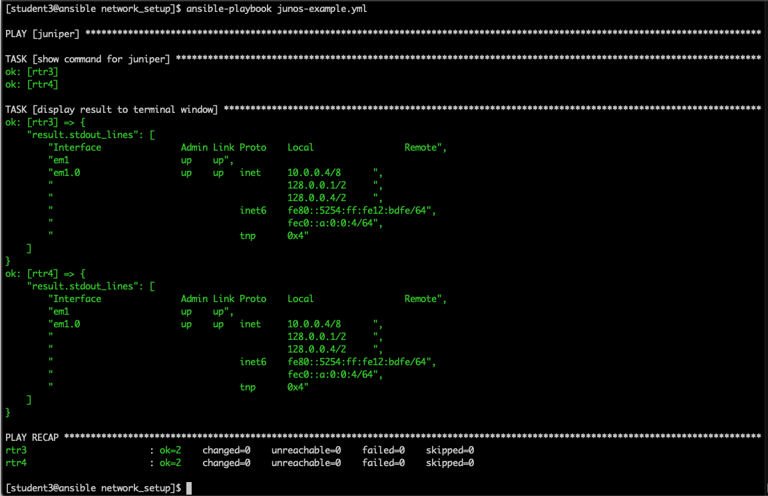
AUTOMATION FOR EVERYONE: PLAYBOOK RESULTS

Slide 70
USE CASE: WINDOWS AUTOMATION

Slide 71
WINDOWS AUTOMATION
90+
Windows Modules
1,300+
Powershell DSC resources
ansible.com/windows
Notes:
Think of DSC resources kind of like extended modules. The win_dsc ansible module can dip into a collection of windows specific modules called DSC resources.
###################
Ansible Windows module count can be derived from https://docs.ansible.com/ansible/devel/modules/list_of_windows_modules.html
PowerShell DSC Resources commands (needs to be run on a Windows host)
Unique DSC Resources
Find-DscResource | Measure-Object
Unique DSC Modules
Find-DscResource | Select-Object -Property modulename -Unique | Measure-Object
Builtin DSC Resources (comes pre-installed with Windows and at this time is around 20 resources)
https://docs.microsoft.com/en-us/powershell/dsc/resources/resources
A DSC Resource is comparable to an Ansible module where it manages an individual resource whereas a DSC Module is a collection of similar resources, e.g. a DSC Module that can be downloaded would be xHyper-V https://github.com/PowerShell/xHyper-V. It contains numerous resources like MSFT_xVMHyperV, MSFT_xVMHost and so on https://github.com/PowerShell/xHyper-V/tree/dev/DSCResources. The code quality of each DSC resource varies as they are public and potentially managed outside of Microsoft. This is similar to the wide range of quality that can be found on Ansible Galaxy.

Slide 72
Native Windows support uses PowerShell remoting to manage Windows in the same Ansible agentless way
WHAT CAN I DO USING ANSIBLE FOR WINDOWS
Install and uninstall MSIs
Gather facts on Windows hosts
Enable and disable Windows features
Start, stop, and manage Windows Services
Create and Manage local users and groups
Manage Windows packages via Chocolatey package manager
Manage and install Windows updates
Fetch files from remote sites
Push and execute any Powershell scripts
Notes:
When we say Windows Automation, what do we mean?
Here are a few specific example use cases that are currently available to execute via the Modules/Roles in Ansible today.

Slide 73
Windows modules
Ansible modules for Windows automation typically begin with win_*
win_copy - Copies files to remote locations on windows hosts
win_service - Manage and query Windows services
win_domain - Ensures the existence of a Windows domain
win_reboot - Reboot a windows machine
win_regedit - win_regedit – Add, change, or remove registry keys and values
win_ping - A windows version of the classic ping module
win_dsc - Invokes a PowerShell DSC configuration
win_acl - Set file/directory/registry permissions for a system user or group
Notes:
Some of the Windows modules are a Windows version for classic modules. Win_ping instead of ping, win_copy and win_service instead of copy and service. The majority of Windows modules are specific to the Windows platform and allow Ansible to interact with classic Windows functionality like the registry, windows domains and PowerShell Desired State Configuration resources
Think of DSC resources kind of like extended modules. The win_dsc ansible module can dip into a collection of windows specific modules called DSC resources.

Slide 74
---
- name: start IIS/stop firewall
hosts: windows-web
become: yes
tasks:
- name: IIS is running
win_service:
name: W3Svc
state: running
- name: firewall service is stopped/disabled
win_service:
name: MpsSvc
state: stopped
start_mode: disabled
Notes:
Playbook example:
The name fields are human-readable comments. Optional, but useful as comments to the Playbook. These strings also show up in Tower, so it is easy to correlate any failures in a long running Playbook.
Inventory call-out
Variables can be handled in several different ways:
Directly in the playbook
As part of a separate vars file
Via the command line
As output from a previous play
Via Tower
You are not required to use root as the remote user. You can have Ansible connect and run the playbook as any user or even multiple users – as long as that user has the permission to perform the tasks in the playbook. You can even use multiple users and specify different users for different plays or tasks.
Ansible supports sudo, su, powerbroker, and other privilege escalation mechanisms.
The real work. General format:
<<module>>: key=value

Slide 75
AUTOMATION FOR EVERYONE: WINDOWS ADMINS
---
- name: windows playbook
hosts: new_servers
tasks:
- name: ensure local admin account exists
win_user:
name: localadmin
password: '{{ local_admin_password }}'
groups: Administrators
Notes:
Playbooks written for Windows are just as simple and easy to read as playbooks written for any other platforms
This playbook simply ensures that a local account has been created with a specific password and that account has been added to the admin group
But nobody in my organization uses local accounts, we have an AD like everybody else...

Slide 76
AUTOMATION FOR EVERYONE: WINDOWS USERS
---
- name: Created AD user account
win_domain_user:
name: “{{ win_user_name }}”
firstname: “{{ win_user_firstname }}”
surname: “{{ win_user_surname }}”
password: “{{ win_user_password }}”
groups: “{{ win_user_groups }}”
state: present
email: “{{ win_user_email }}”
Notes:
Purpose of playbook: Creates a new windows user; adds it to one or more groups; verifies that each group exists if not the group itself is created; can also emails manager with new account info
Common use case would be for HR rep to use this playbook to create a new user without involving IT Support
Focus on how easy it is to read and understand what the playbook is doing with no prior coding skills
You can mention the 2nd half of playbook is the email to manager which is optional so the real work in done in less than 20 lines

Slide 77
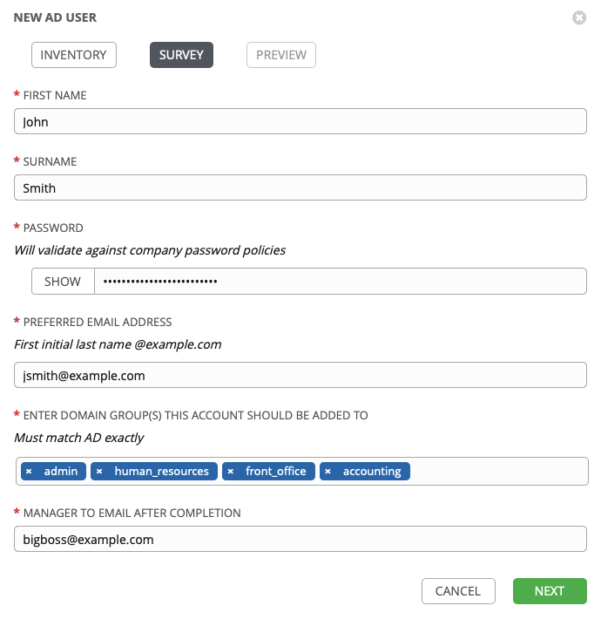
AUTOMATION FOR EVERYONE: WINDOWS USERS
Notes:
Now speak to the Ansible Tower Survey and how easy and non technical the form is to fill out
Point out the password is hidden
Point out the group membership is a drop down and can be multi-select

Slide 78
AUTOMATION FOR EVERYONE: WINDOWS UPDATES (SIMPLE)
---
- name: ensure common OS updates are current
win_updates:
register: update_result
- name: reboot and wait for host if updates change require it
win_reboot:
when: update_result.reboot_required
Notes:
This playbook would simply apply all outstanding updates across this inventory and only reboot when necessary
But we don’t always want to apply all updates. Occasionally, we need to blacklist certain KBs…

Slide 79
AUTOMATION FOR EVERYONE: WINDOWS UPDATES (COMPLEX)
---
- name: ensure common OS updates are current
Win_updates:
category_names: “{{ categories }}”
blacklist: “{{ blacklist_package | default(omit, true) }}”
whitelist: “{{ whitelist_package | default(omit, true) }}”
register: update_result
- name: reboot and wait for host if updates change require it
win_reboot:
when: update_result.reboot_required
Notes:
Playbook Purpose: Installs windows updates that match the category
Note that you can use regex notation on the whitelist or blacklist parameter to include or exclude specific updates
You no longer need a separate task to reboot after the updates are installed

Slide 80
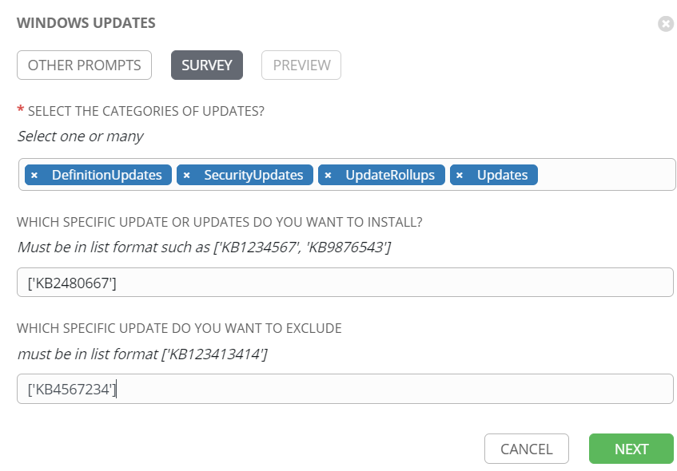
AUTOMATION FOR EVERYONE: WINDOWS UPDATES (COMPLEX)
Notes:
Point out how the categories are a drop down list
If blacklist and whitelist parameters are left blank all updates in the selected categories will be installed
Once again point out how easy it is to run this playbook. Windows Admins don’t have to run these just set them up. NOC/Helpdesk can run them
OR they can be scheduled and run automatically during late night change window

Slide 81
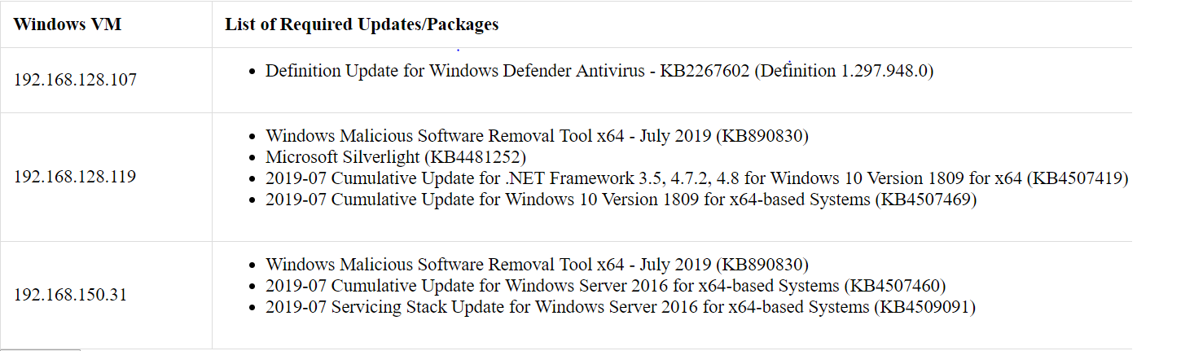
AUTOMATION FOR EVERYONE: WINDOWS UPDATES (COMPLEX)
Notes:
Extra slide for updates use case. Point out that if you just want to check and get a report on what updates are need you can run a playbook to do just that
Emails you an html report that is printable and searchable to filter out exactly the update you are looking for

Slide 82
AUTOMATION FOR EVERYONE: DOMAIN MEMBERSHIP
---
- name: update domain and reboot
hosts: windows_servers
tasks:
- name: ensure domain membership
win_domain_membership:
dns_domain_name: contoso.corp
domain_admin_user: '{{ domain_admin_username }}'
domain_admin_password: '{{ domain_admin_password }}'
state: domain
register: domain_result
- name: reboot and wait for host if domain change require it
win_reboot:
when: domain_result.reboot_required
Notes:
Convey that we understand that you almost can’t do anything on Windows without joining a domain.
We make that very easy with this playbook to configure our domain memberships
We can also create and teardown domains very easily. This comes in handy when creating ephemeral instances or dev stacks to test an application deployment/migration on fresh instances. Typically, we’d create these instances and join an existing domain and as we build and teardown, we leave garbage entries behind. Ansible makes creating and destroy domains just as easy as individual hosts joining an existing domain.

Slide 83
USE CASE: Cloud automation

Slide 84
CLOUD AUTOMATION
800+
Cloud Modules
30+
Cloud Platforms
ansible.com/cloud
Notes:
Microsoft Azure, Google Compute Engine (GCE), Amazon Web Services, Red Hat Openstack, and more
https://docs.ansible.com/ansible/devel/modules/list_of_cloud_modules.html

Slide 85
PLAYBOOK EXAMPLE: AWS
---
- name: aws playbook
hosts: localhost
connection: local
tasks:
- name: create AWS VPC ansible-vpc
ec2_vpc_net:
name: "ansible-vpc"
cidr_block: "192.168.0.0/24"
tags:
demo: the demo vpc
register: create_vpc

Slide 86
PLAYBOOK EXAMPLE: AZURE
---
- name: azure playbook
hosts: localhost
connection: local
tasks:
- name: create virtual network
azure_rm_virtualnetwork:
resource_group: myResourceGroup
name: myVnet
address_prefixes: "10.0.0.0/16"

Slide 87
PLAYBOOK EXAMPLE: RED HAT OPENSTACK
---
- name: openstack playbook
hosts: localhost
connection: local
tasks:
- name: launch an instance
os_server:
name: vm1
cloud: mordred
region_name: ams01
image: Red Hat Enterprise Linux 7.4
flavor_ram: 4096

Slide 88
USE CASE: Security Automation

Slide 89
ANSIBLE SECURITY AUTOMATION
11+
Security Platforms
800+
Security Modules
ansible.com/use-cases/security-automation
Notes:
Ansible Network modules comprise 1/3 of all modules that ship with Ansible Engine.

Slide 90
What Is It?
Ansible Security Automation is our expansion deeper into the security use case. The goal is to provide a more efficient, streamlined way for security teams to automate their various processes for the identification, search, and response to security events. This is more complex and higher-value than the application of a security baseline (PCI, STIG, CIS) to a server.
Ansible Security Automation is a supported set of Ansible modules, roles and playbooks designed to unify the security response to cyberattacks.

Slide 91



What Does It Do?
Triage Of Suspicious Activities
Threat Hunting
Incident Response
Enabling programmatic access to log configurations such as destination, verbosity, etc.
Automating alerts, correlation searches and signature manipulation
Creating new security policies to whitelist, blacklist or quarantine a machine

Slide 92













Partners - Security ISVs
Security Information & Events Management
Enterprise Firewalls
Intrusion Detection & Prevention Systems
Privileged Access Management

Slide 93
AUTOMATION FOR EVERYONE: SECURITY OPERATIONS
---
- name: Create access rule in Checkpoint
hosts: checkpoint
connection: httpapi
tasks:
- name: create access rule
checkpoint_access_rule:
layer: Network
name: "Drop attacker"
position: top
source: attacker
destination: Any
action: Drop

Slide 94
AUTOMATION FOR EVERYONE: SECURITY OPERATIONS
---
- name: Change QRadar rule state
hosts: qradar
tasks:
- name: get info about qradar rule
qradar_rule_info:
name: "Potential DDoS Against Single Host (TCP)"
register: rule_info
- name: disable rule by id
qradar_rule:
state: disabled
id: "{{ rule_info.rules[0]['id'] }}"

Slide 95
AUTOMATION FOR EVERYONE: SECURITY OPERATIONS
---
- name: Add Snort rule
hosts: snort
tasks:
- name: Add snort password attack rule
include_role:
name: "ansible_security.ids_rule"
vars:
rule: "alert tcp any 443 -> 192.168.12.0/24 any"
state: present
rules_file: /etc/snort/rules/grab_everything_http.rules

